Slide 1
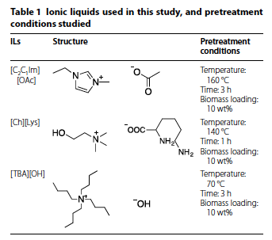
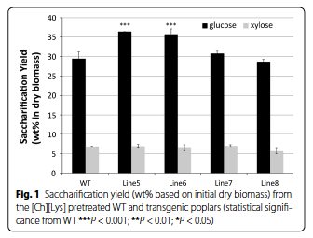
Impact of lignin polymer backbone esters on ionic liquid pretreatment of poplar
Background
Biomass pretreatment remains an essential step in lignocellulosic biofuel production, largely to facilitate the efficient removal of lignin and increase enzyme accessibility to the polysaccharides
There have been significant efforts in planta to reduce lignin content or modify its composition to overcome the inherent recalcitrance
Approach
In this work, transgenic poplar lines in which monolignol ferulate conjugates were synthesized during cell wall development to introduce, during lignification, readily cleavable ester linkages into the lignin polymer backbone (i.e., “Zip lignin” produced by John Ralph at GLBRC) were pretreated with different ionic liquids (ILs).
Outcomes
The strategic introduction of ester bonds into the lignin backbone resulted in increased pretreatment efficiency and released more carbohydrates with lower energy input.
After pretreatment with any of three different ILs, the transgenic poplars, especially those with relatively higher amounts of incorporated monolignol ferulate conjugates, yielding up to 23% higher sugar levels compared to wild-type plants.
Significance
This work clearly demonstrate that the introduction of ester linkages into the lignin polymer backbone decreases biomass recalcitrance in poplar has the potential to reduce the energy and/or amount of IL required for effective pretreatment.
This result could enable the development of an economically viable and sustainable biorefinery process
Kim et al. (2017) “Impact of lignin polymer backbone esters on ionic liquid pretreatment of poplar” Biotechnol Biofuels, 10(1), 101. doi, 10.1186/s13068-017-0784-2

