Slide 1
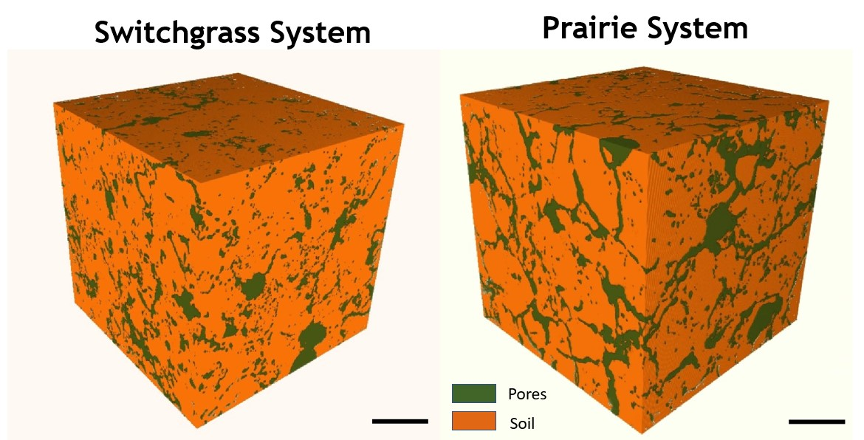
Soil Pores in Bioenergy Systems Affect Greenhouse Gas Emissions
Background/Objective
Bioenergy crops may mitigate climate change by holding carbon in the soil and reducing greenhouse gas emissions
Approach
Explore how soil pore architecture and other factors relate to carbon sequestration and nitrous oxide emissions
Results
Soil pore architecture, topography, and moisture can have a large impact on nitrous oxide emissions and carbon sequestration in soils of perennial bioenergy crops
The 3D visualization of pores in soil cores under different bioenergy cropping systems helps show how they affect carbon sequestration and nitrous oxide emissions from the soil.
Significance/Impacts
Understanding factors that affect carbon and nitrogen cycling in soil will enable better estimates of the potential ecological and climate benefits of bioenergy cropping systems on a variety of soils and terrains and help identify bioenergy lands likely to yield the best environmental outcomes
K. Kim, et al. Soil pore architecture and rhizosphere legacy define N2O production in root detritusphere. Soil Biology and Biochemistry 166, 108565 (2022). [DOI: 10.1016/j.soilbio.2022.108565]
A. Juyal, et al. Pore architecture and particulate organic matter in soils under monoculture switchgrass and restored prairie in contrasting topography. Scientific Reports 11, 21998 (2021). [DOI: 10.1038/s41598-021-01533-7]

