Slide 1

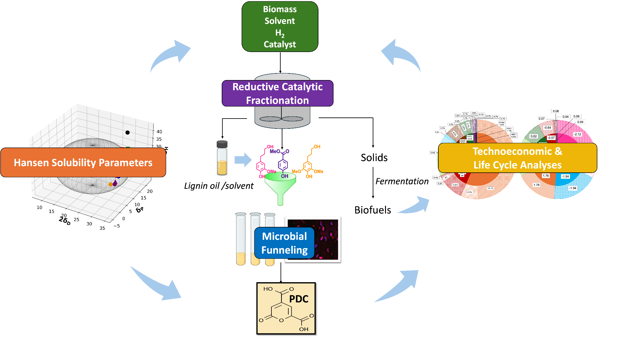
Computational modeling speeds solvent selection for biomass-to-product pipeline
Background/Objective
Reductive catalytic fractionation (RCF) is a promising technique to transform lignin into monomers and oligomers that can be biologically upgraded to high-value products. The choice of solvent affects nearly all aspects of the process. This work evaluated a pipeline using RCF of poplar biomass followed by biological funneling with Novosphingobium aromaticivorans to 2-pyrone-4,6-dicarboxylic acid (PDC), a potential bioplastic precursor, using six pure solvents and variations of aqueous mixtures.
Approach
Scientists investigated six solvents (methanol, ethanol, isopropanol, isobutanol, 1,4-dioxane, and ethylene glycol) and their aqueous mixtures (5–50 vol% water), for a total of 30 solvent systems. They developed a computational model to correlate experimentally-determined monomer and PDC yields with the Hansen solubility parameters of each solvent. They modeled operation of an integrated poplar-to-PDC biorefinery for 12 solvent systems (six pure solvents and 50% aqueous mixtures), providing comprehensive techno-economic analysis and life cycle assessment insights into solvent selection.
Schematic of integrated experimental-modeling approach
Results
Analyses identified a 50 %vol methanol/water system as optimal because it reduces RCF reactor pressure and is compatible with microbial funneling by N. aromaticivorans. This system produced 63 g PDC per kg biomass from 85 g phenolic monomers per kg biomass at a reactor pressure of 48 bar (reduced 26% compared to previous work). The minimum selling price for the system is $13.98 per kg of purified PDC, a reduction of 24% compared to previous work. The carbon footprint was 1.47 kg CO₂e/kg.
Significance/Impacts
One of the most abundant biopolymers on Earth, lignin is a potential feedstock for sustainable high-value bioproducts. This work identified solvent systems that maximize product yields at lower reactor pressure, which could reduce the cost of producing plant-based chemicals. Modeling tools developed here could be used to speed up solvent selection for other systems without extensive physical experiments.
Sripada, S., et al. Solvent selection for a biomass-to-bioproduct pipeline through integrated reductive catalytic fractionation and microbial funneling. Green Chemistry. (2026). [DOI:10.1039/D5GC06557G]

