Slide 1
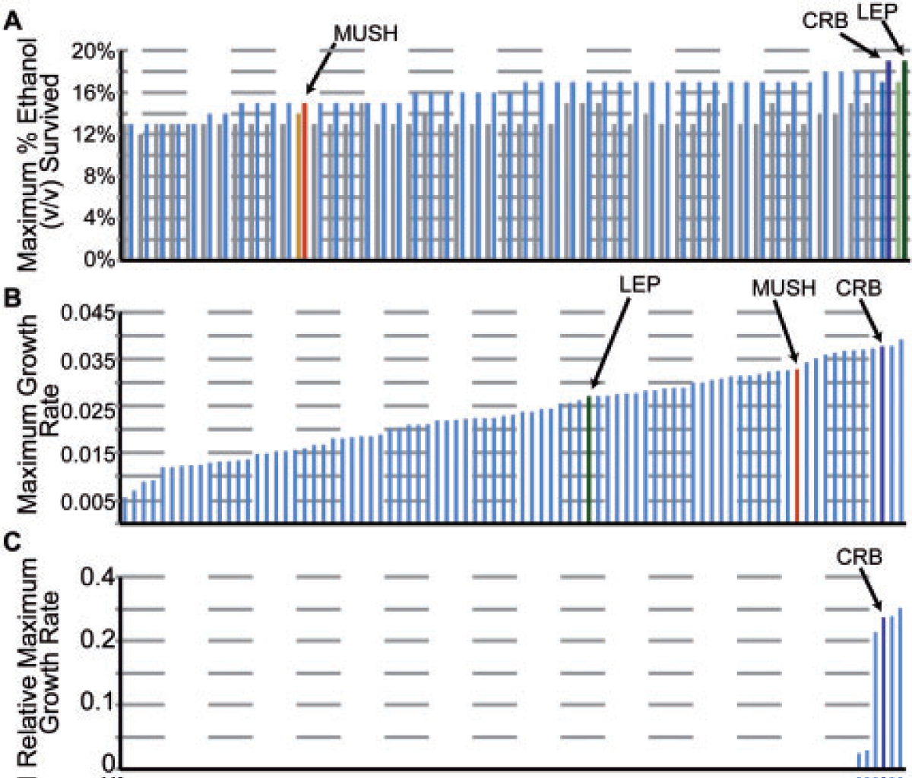
BRC Science Highlight
Naturally occurring yeast strains applicable for bioenergy production have genetic determinants functionally linked to stress tolerance
Objective To understand the genetic basis for traits relevant to bioenergy production and gain insight into mechanisms by which naturally occurring yeast strains become adapted to stress.
Approach
We characterized three wild strains of S. cerevisiae with robust growth in AFEX hydrolysate or increased tolerance to heat or ethanol via genome and transcriptome sequencing analysis.
Identified changes provide insight into the phenotype and mechanism(s) for tolerance.
Result/Impacts
Stress-tolerant strains contained genetic signatures from several different yeast lineages, suggesting that genetic admixture contributes to stress tolerance.
Gene sets not found in the reference laboratory strain were functionally linked to tolerance.
Naturally occurring yeast strains contain a wealth of genetic diversity that could be mined for biofuel strain engineering efforts.
Wohlbach D. J. et. al. 2014. Comparative Genomics of Saccharomyces cerevisiae Natural Isolates for Bioenergy Production. Genome Biol. Evol., 6 (9), 2557-2566.
GLBRC January 2015
Notes:
Notes:
text
Title again:
Text 1-2 sentence summary?

