Slide 1
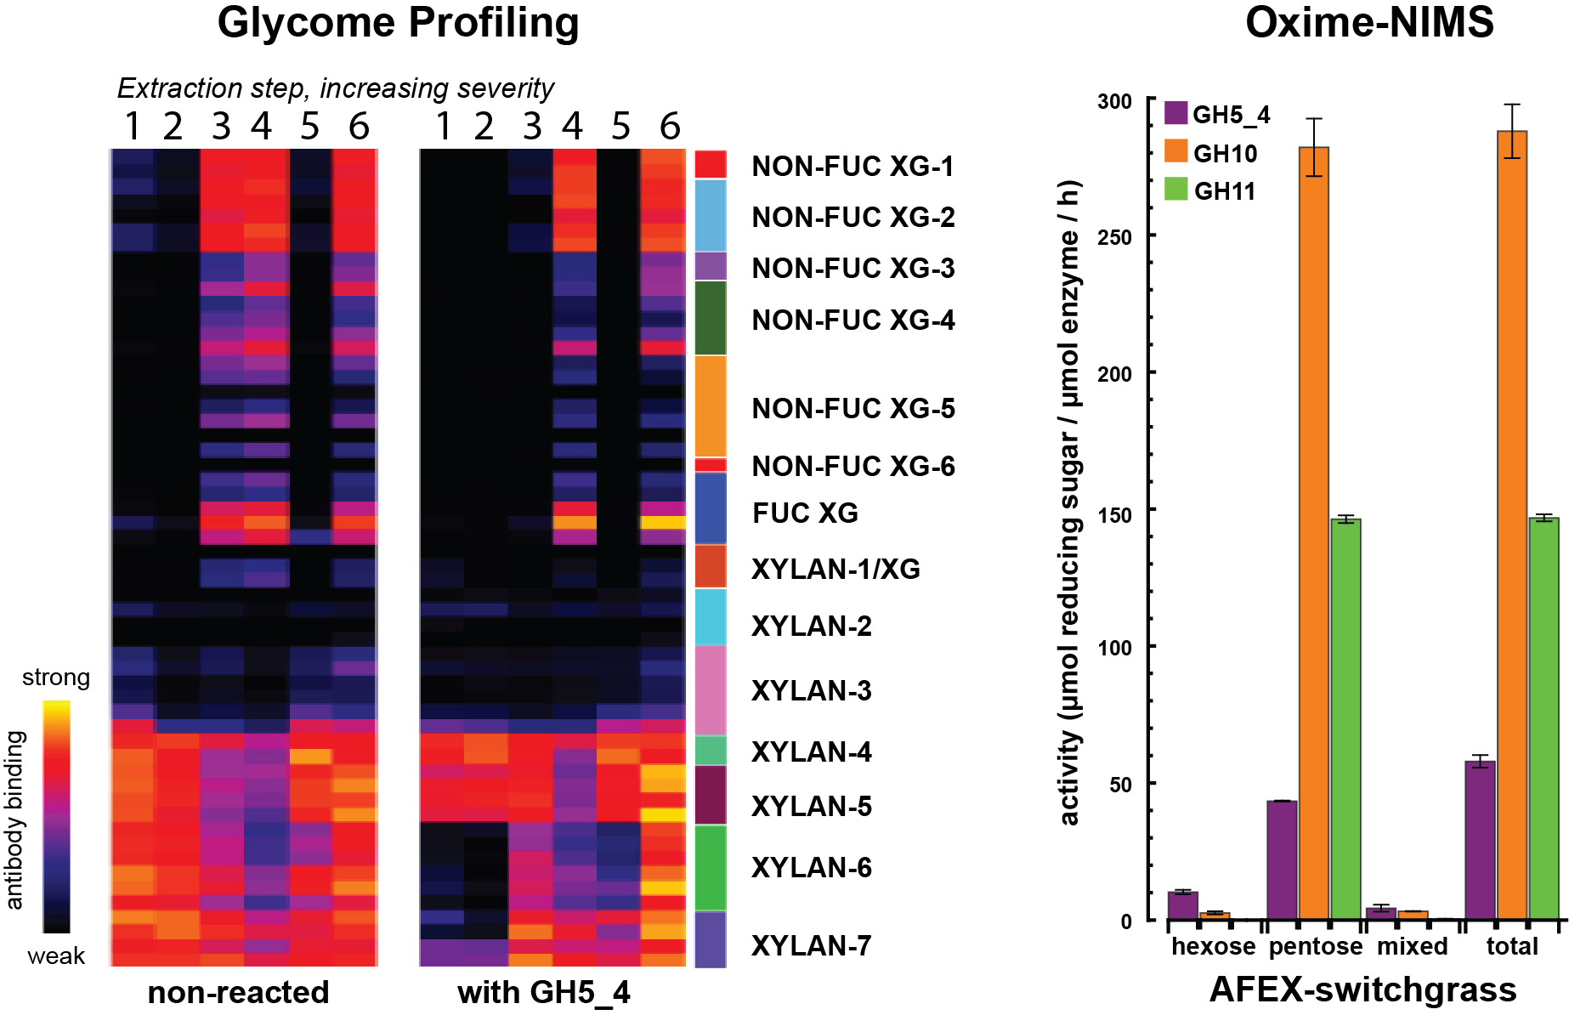
BRC Science Highlight
Fine-tuned identification of glycoside hydrolase specificity on plant cell walls
Objective Identify the substrate preferences and product profiles of glycoside hydrolases on biomass substrates
Approach
Collaboration of GLBRC, BESC, and JBEI, with antibodies developed with the NSF plant genome program
Use glycome profiling of non- or AFEX-pretreated corn stover or switchgrass to identify plant cell-wall carbohydrate epitopes eliminated by enzymatic hydrolysis
Quantitative nanostructure initiator mass spectroscopy (oxime-NIMS) used to profile pentose and hexose products of enzyme/biomass reaction
Result/Impacts
Combined biomass-centered approaches provide a detailed assessment of enzyme specificity and end-product profiles and efficacy of biomass pretreatments
Distinct substrate differences were identified between xylanase classes GH10 and GH11 and multifunctional enzyme class GH5_4
Walker JA, Pattathil S, Bergeman LF, Beebe ET, Deng K, Mirzai M, Northen TR, Hahn MG, Fox BG “Determination of Glycoside Hydrolase Specificities During Hydrolysis of Plant Cell Walls Using Glycome Profiling”. Biotechnol. Biofuels. 10 (31), (2017) [DOI: 10.1186/s13068-017-0703-6]
GLBRC April 2017
Notes:
Notes:
text
Title again:
Text 1-2 sentence summary?

