Slide 1
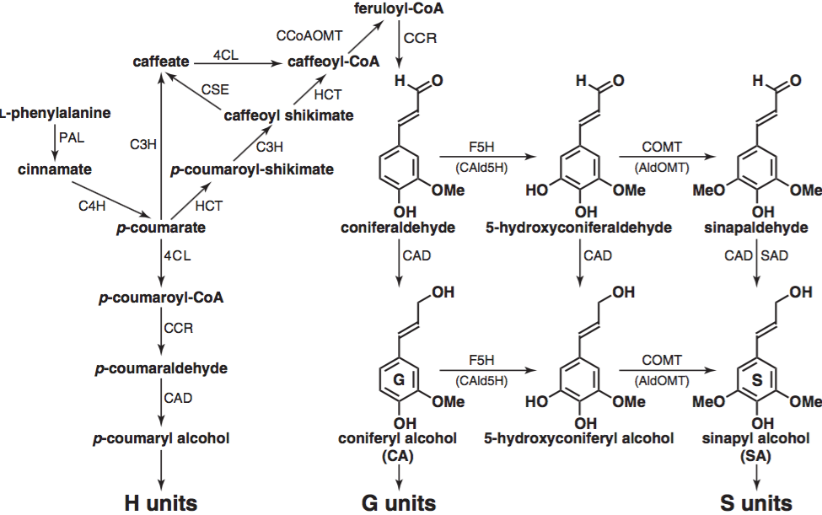
BRC Science Highlight
Syringyl lignin production in conifers: Proof of concept in a Pine tracheary element system
Objective
The objective of this study was to produce hardwood-like lignin containing syringyl (S) units in conifers by metabolic engineering of the phenylpropanoid pathway.
Approach
Genes that encode F5H, COMT, and SAD, which are enzymes involved in the synthesis of sinapyl alcohol (denoted by green boxes in the figure), were transformed into Pinus radiata undifferentiated callus cultures.
Transgenic cell lines were induced to differentiate into lignified tracheary elements (TEs).
The expression patterns for F5H, COMT, SAD and other endogenous lignin-related genes were analyzed during TE differentiation.
Pyrlolysis-GC/MS and 2D-NMR spectroscopy were used to chemically analyze wild-type (WT) and transgenic TE cultures for the presence of S lignin.
Result/Impacts
F5H, COMT, and SAD were successfully expressed in several transgenic TE lines.
Pyrograms of TEs from all transgenic lines showed the presence of S lignin and pathway intermediates.
Although no S lignin was observed in WT TE preps, NMR analysis of transgenic lines showed diagnostic signatures for S lignin.
This study shows that metabolic engineering can be used to introduce S monomers into conifer lignin, which has the potential to improve the processing of conifer-derived biomass in the biofuel and chemical pulping industries.
Wagner A, Tobimatsu Y, Phillps L, Flint H, Geddes B, Fashuang L, & Ralph J. Syringyl lignin production in conifers: Proof of concept in a Pine tracheary element system. PNAS doi: 10.1073/pnas.1411926112
GLBRC April 2015
Notes:
Notes:
text
Title again:
Text 1-2 sentence summary?

