Slide 1
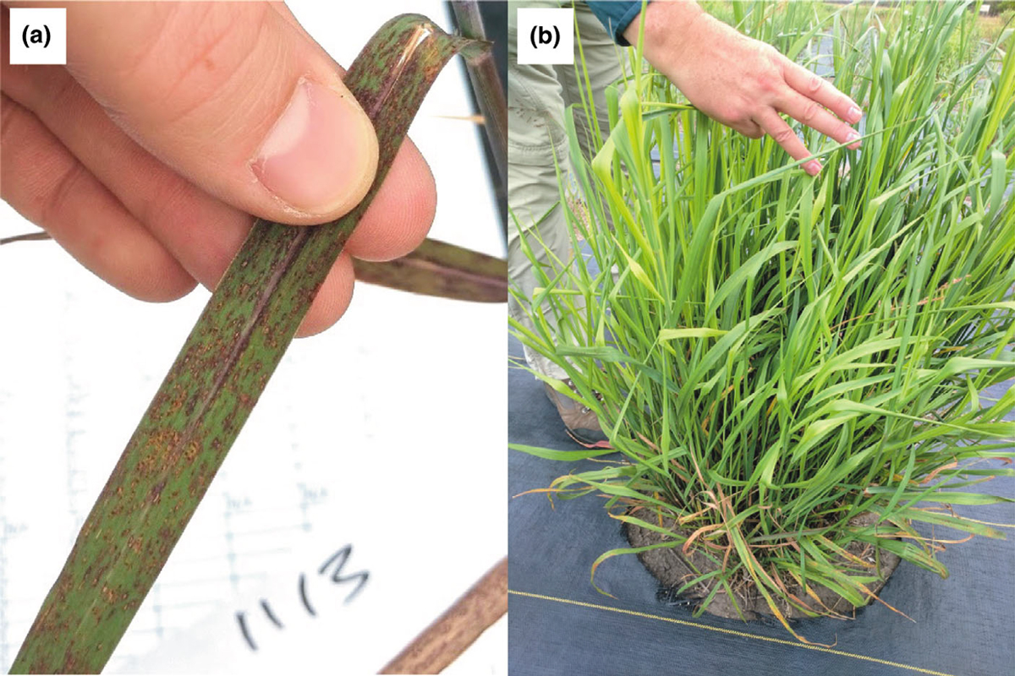
BRC Science Highlight
Geographic adaptations impact switchgrass resistance to rust infections
Objective Understand the environmental and genetic and factors underlying variation in rust resistance in upland and lowland switchgrass across the central U.S.
Approach
Map rust severity and quantitative trait locus (QTL) in switchgrass across eight sites spanning 1,500 km in latitude.
Collect rust severity and QTL data for three consecutive years.
(Left) Switchgrass leaf heavily infected with rust and (right) switchgrass plant lightly infected with rust.
Result/Impacts
Two large effect QTLs explain differences between switchgrass ecotypes, particularly in the northern sites but have limited effect on the switchgrass grown in the southern sites.
Environmental factors dependent on latitude impact genes that control switchgrass rust resistance.
Assaying pathogen resistance across both time and space is crucial to understand how genetic and environmental factors impact rust resistance in switchgrass.
VanWallendael, A. et al., “Geographic variation in the genetic basis of resistance to leaf rust between locally adapted ecotypes of the biofuel crop switchgrass (Panicum virgatum).” New Phytologist (2020). [DOI:10.1111/nph.16555]
GLBRC June 2020
Notes:
Notes:
text
Title again:
Text 1-2 sentence summary?

