Slide 1
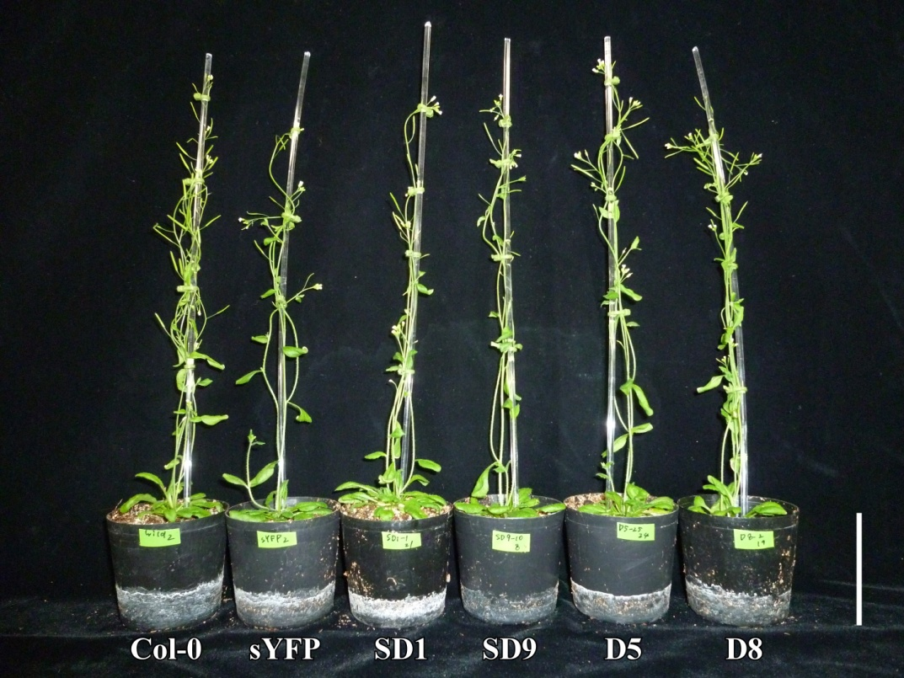
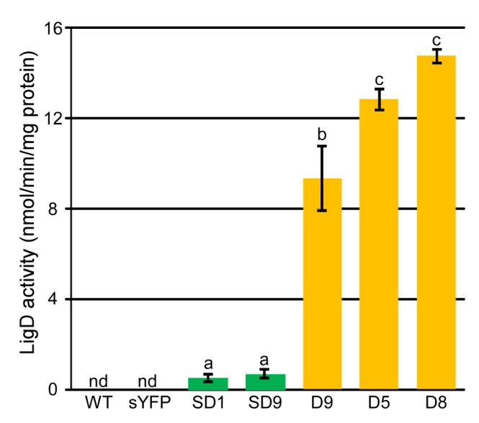
BRC Science Highlight
Introduction of chemically labile units into lignin
Objective To engineer plants for better biomass processability; to reduce the need for/cost of pretreatments by altering lignin content or composition in bioenergy feedstocks.
Approach
Arabidopsis thaliana, a model plant, was engineered to express Cα-dehydrogenase (LigD) from Sphingobium sp. SKY-6, one of the best-characterized lignin degrading enzymes.
This enzyme has been shown, in-vitro, to oxidize the most abundant linkage in native lignin (β-O-4) to a more labile (α-keto) analogue.
Enzyme activity in transgenic plants was determined using RT-PCR and Western blot analysis; UPLC-MS was used for phenolic profiling; 2D NMR was used to determine cell wall composition and lignin structure.
Result/Impacts
Transformation was able to alter lignin structure in the desired manner; LigD tolerates variations in side-chains of native lignin transgenic lines
Total lignin in transgenics was similar to WT, had more of the desired α-keto linkages; no change in saccharification efficiency was detected.
LigD was successfully expressed and enzyme activity detected in extracts of transgenic species and was shown to oxidize a wider range of β-O-4-linked molecules than previously known.
Tsuji Y., Vanholme R., Tobimatsu Y., Ishikawa Y., Foster C. E., Kamimura N., Hishiyama S., Hashimoto S., Shino A., Hara H., Sato-Izawa K., Oyarce P., Goeminne G., Morreel K., Kikuchi J., Takano T., Fukuda M., Katayama Y., Boerjan W., Ralph J., Masai E. and Kajita S. (2015) Introduction of chemically labile substructures into Arabidopsis lignin through the use of LigD, the Cα-dehydrogenase from Sphingobium sp. strain SYK-6. Plant Biotechnol. J., doi: 10.1111/pbi.12316
GLBRC March 2015
Notes:
Notes:
http://onlinelibrary.wiley.com/doi/10.1111/pbi.12316/abstract

