Slide 1
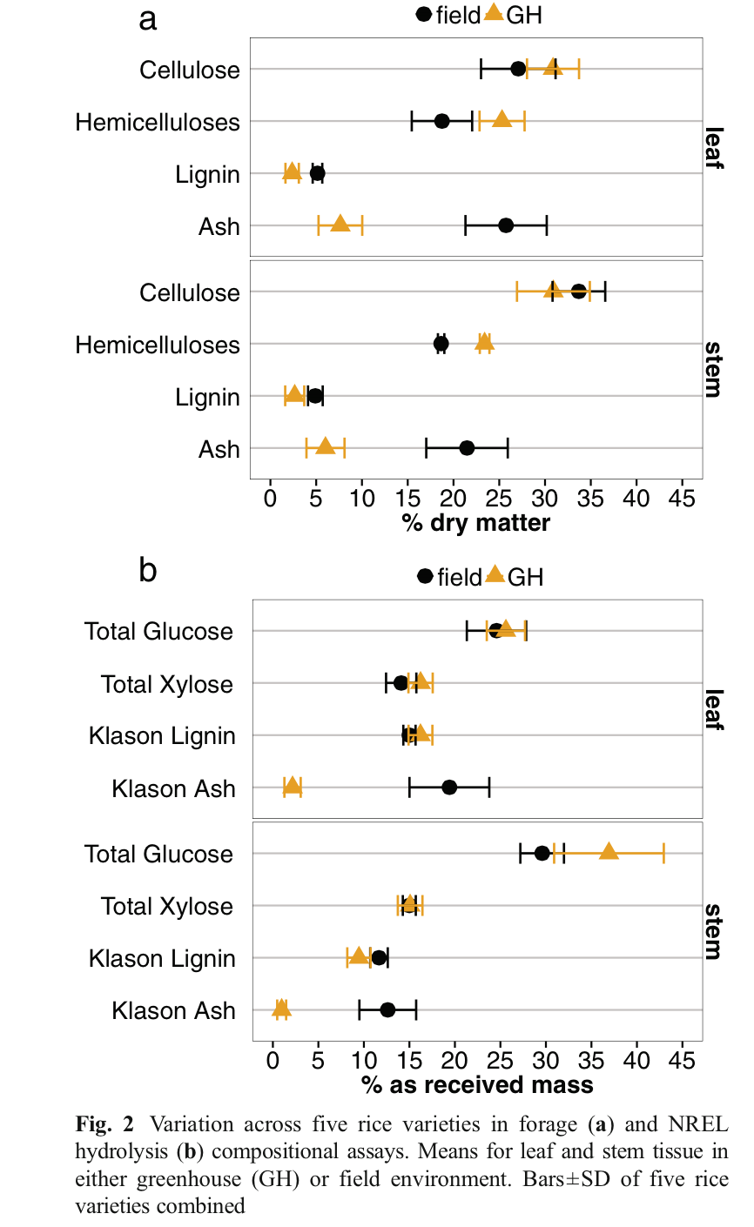
BRC Science Highlight
Cell Wall Composition and Bioenergy Potential of Rice Straw Tissues Are Influenced by Environment, Tissue, Type and Genotype
Objective
To optimize greenhouse and field breeding trials, we used a variety of compositional assays to identify biomass compositional trends between rice varieties and tissue types that translate successfully from greenhouse to field grown plants.
Approach
20 diverse rice varieties were grown in greenhouses and fields.
An array of compositional assays were used to identify compositional trends between varieties and tissue types across growth conditions. Compositional assays include analysis of cell wall polysaccharides (cellulose and hemicellulose), lignin, ash, enzyme saccharification, hydroxyproline, and bulk density.
Result/Impacts
Rice variety had the least effect on traits measured in this study, while growth environment (greenhouse versus field) had the greatest effect.
Yield of greenhouse-grown biomass was significantly higher than field grown biomass, which indicates that studies utilizing greenhouse grown biomass overestimate yield.
The authors conclude that glucose yield of greenhouse-grown plants is a good predictor of glucose yield in field grown plants and could be used to optimize greenhouse and field breeding trials.
Tanger P, Vega-Sanchez ME, Fleming M, Tran K, Singh S, Abrahamson JB, Jahn CE, Santoro N, Naredo EB, Baraoidan M, Danks JMC, Salt DE, McNally KL, Simmons BA, Ronald PC, Leung H, McKay JK, Leach JE. Cell Wall Composition and Bioenergy Potential of Rice Straw Tissues Are Influenced by Environment, Tissue Type, and Genotype. Bioenergy Research. 2015 Jan 11. DOI 10.1007/s12155-014-9573-y
GLBRC February 2015
Notes:
Notes:
text
Title again:
Text 1-2 sentence summary?

