Slide 1
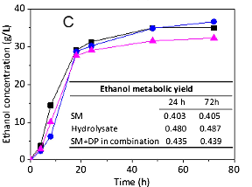
BRC Science Highlight
Using a designer synthetic media to understand inhibitors effect in biomass conversion
Objective To understand the mechanisms of inhibition that affect microorganisms during fermentation in lignocellulosic biomass conversion.
Approach
Characterized nutrients and decomposition products present in AFEX-pretreated corn stover hydrolysate in order to formulate a synthetic hydrolysate.
This synthetic hydrolysate was used to screen the effect of different classes of AFEX-pretreated biomass decomposition products on xylose-fermentation using a recombinant S. cerevisiae 424A (LNH-ST) strain.
Result/Impacts
The synthetic hydrolysate, while not effectively matching the actual hydrolysate in terms of fermentation profile, was effective for studying the inhibitory effect of various compounds on yeast fermentation.
Though most of the families of decomposition products were inhibitory to xylose fermentation, N compounds (most abundant) showed the most inhibition, especially amides.
Tang X, daCosta Sousa L, Jin M, Chundawat SPS, Chambliss CK, Lau MW, Xiao Z, Dale BE, and Balan V. “Designer synthetic media for studying microbial-catalyzed biofuel production”. Biotechnology and Biofuels (2015). doi:10.1186/s13068-014-0179-6
GLBRC January 2015
Notes:
Notes:
text
Title again:
Text 1-2 sentence summary?

