Slide 1
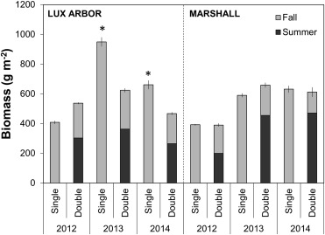
BRC Science Highlight
Impact of Harvest Frequency on Tallgrass Prairie
Biomass Production & Species Composition
Objective
Determine the effects of single vs. double harvests of native perennial grasslands grown as lignocellulosic biofuel feedstock on biomass production and plant community composition.
Approach
Two study sites in southwest Michigan were planted with the same mixture of prairie species in 2010.
From 2012 to 2014, experimental plots were harvested in September only, or in July and September.
Data were collected on biomass production and species composition.
Biomass production from the prairie communities at Lux Arbor and Marshall Farm by year and harvest frequency. Asterisks above bars designate significant (p < 0.05) pairwise contrasts between the single and double harvests within each site and year.
Result/Impacts
Despite being planted with the same seed mixture, the plant communities that established at the two sites were markedly different, perhaps due to effects of past land use and/or site conditions.
At the site dominated by C₄ warm season grasses, more total biomass was produced when plots were harvested only once instead of twice.
At the site with greater plant species diversity, total biomass production was not impacted by harvesting frequency.
Overall, while our results indicate that a single end-of-harvest will maximize biomass production, a double harvest on more diverse sites may result in an increase in other ecosystem services without decreasing biomass yield.
Stahlheber, K. A. et al. “Balancing biofuel production and biodiversity: Harvesting frequency effects on production and community composition in planted tallgrass prairie.” Biomass and Bioenergy 92, 98-105 (2016) DOI: 10.1016/j.biombioe.2016.06.012
GLBRC February 2017
Notes:
Notes:
text
Title again:
Text 1-2 sentence summary?

