Slide 1
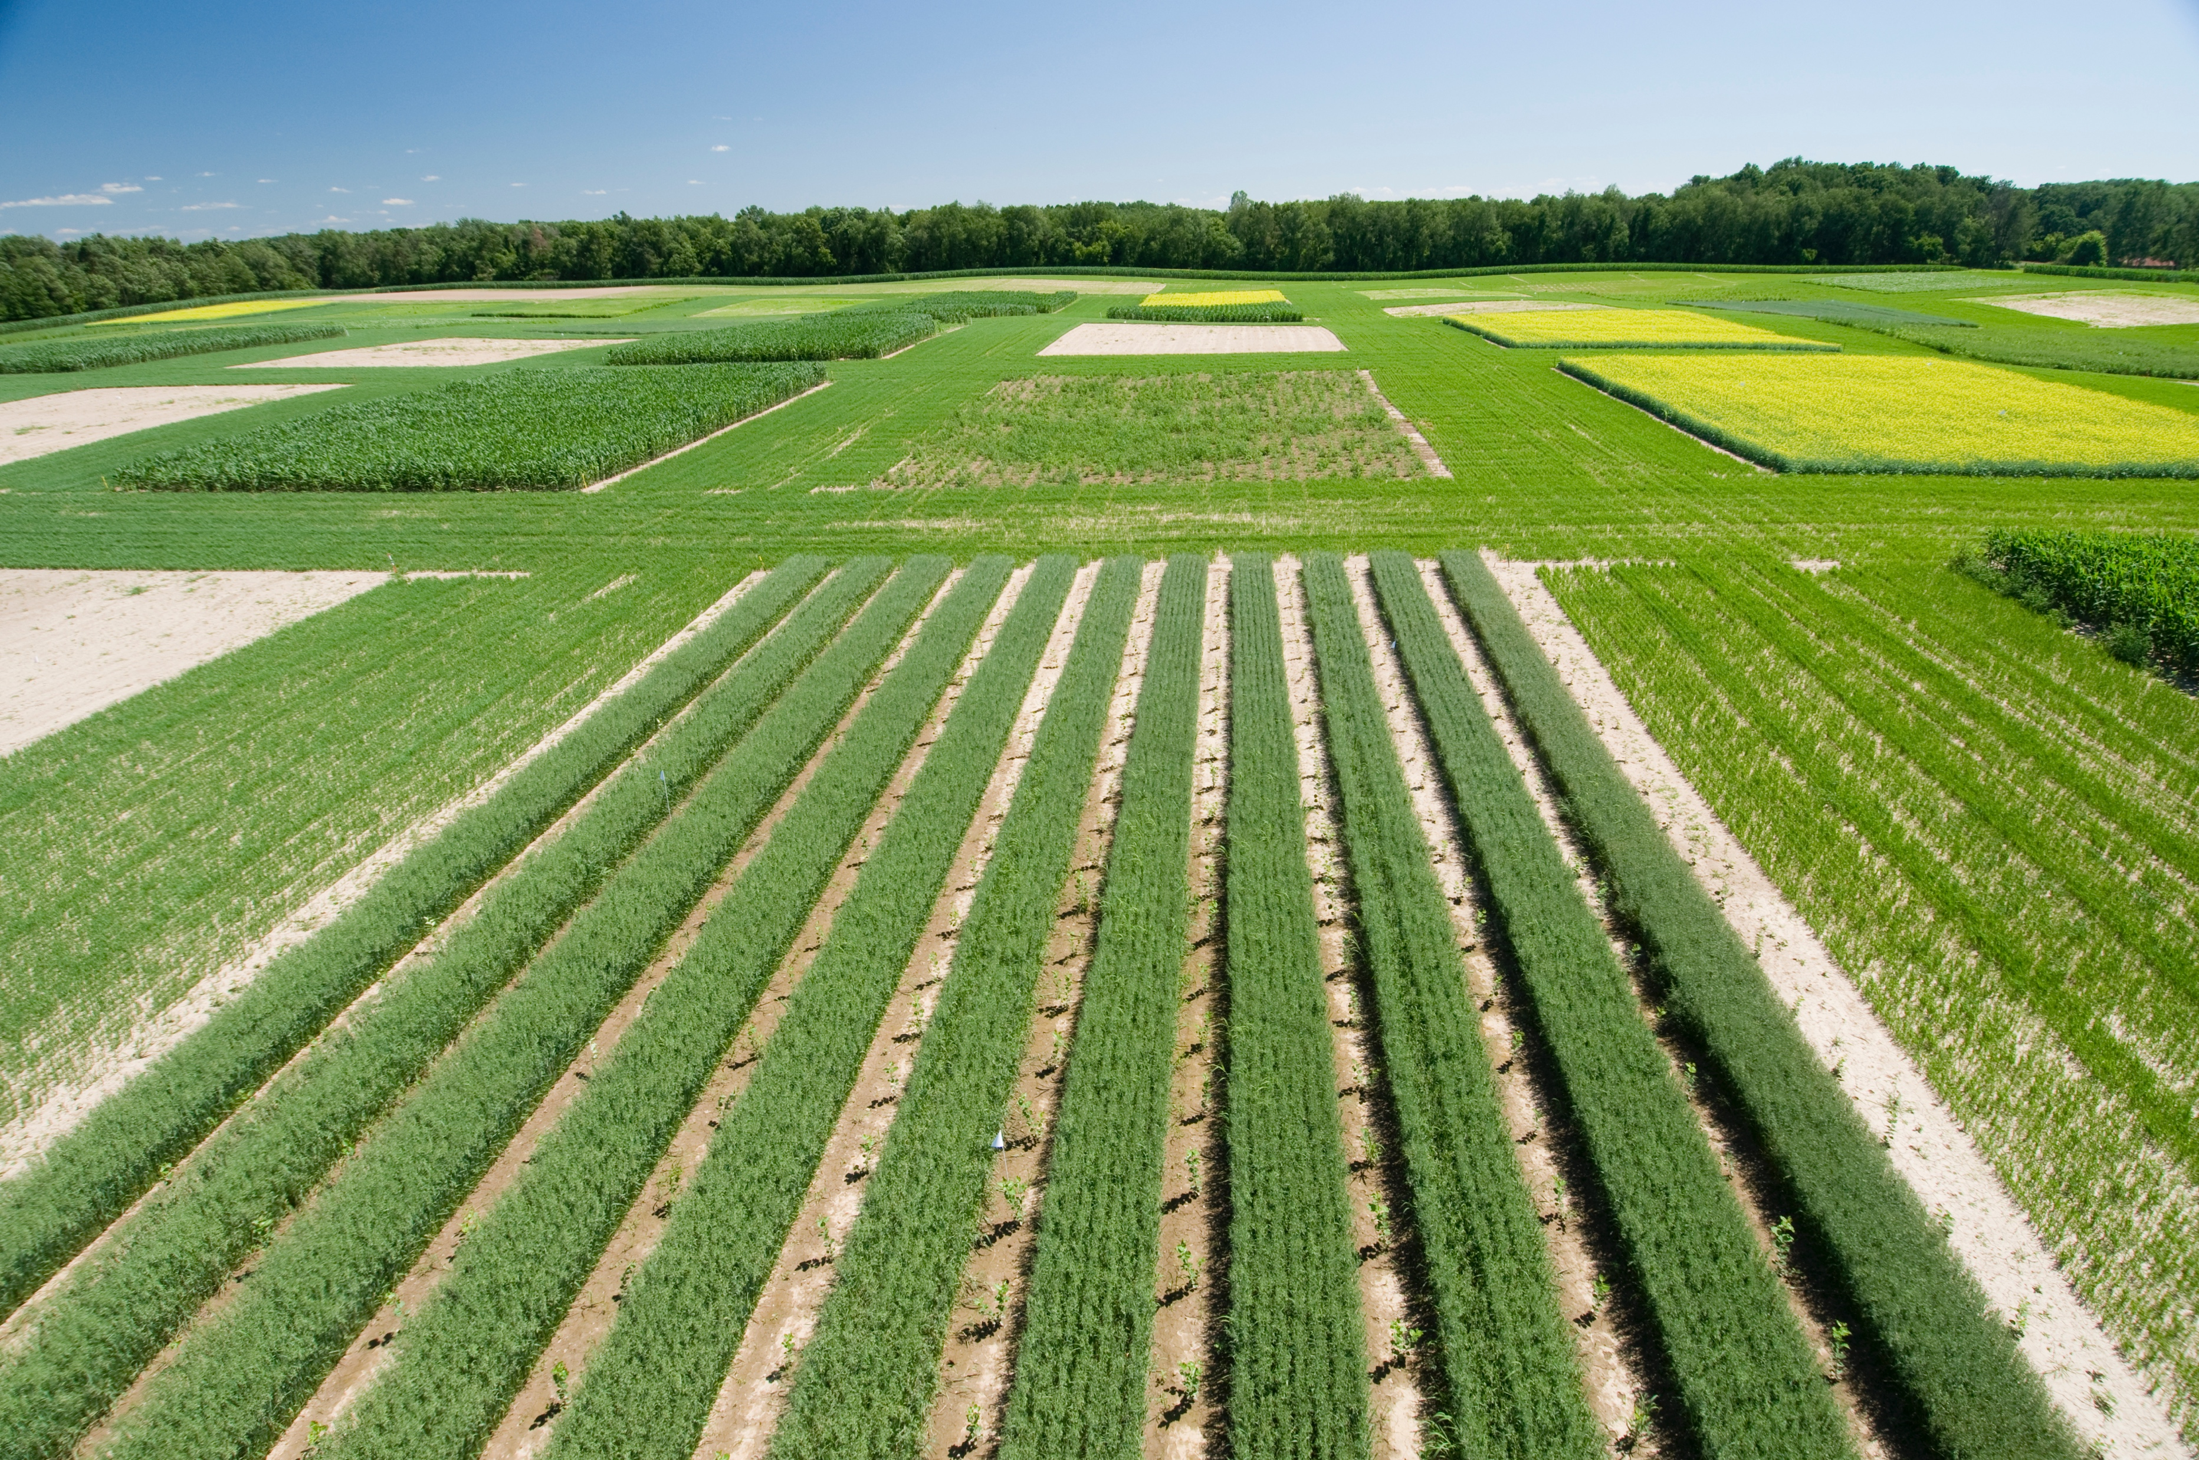
BRC Science Highlight
Spatial dependence and its effect on available land for bioenergy crops
Objective
To empirically analyze whether spatial dependence among landowners affects their willingness to make land available for bioenergy production.
Approach
Surveyed 599 owners of non-crop marginal lands in southern Michigan.
Survey included data related to willingness to rent land for production of bioenergy crops (including various rentals, contract lengths, types of land, and various bioenergy crops), current land use patterns, land management practices, environmental attitudes and concerns related to bioenergy production, and socioeconomic variables.
Bioenergy feedstocks at the Kellogg Biological Station
Results
Intentions to rent land for bioenergy crop production are spatially dependent, resulting from both the land supply intentions of nearby landowners, and from spatial spillover effects of landowner characteristics and attitudes towards environmental aspects of land rental.
Ignoring spatial dependence in the intentions of neighboring landowners to participate in land rental markets for bioenergy feedstocks can lead to distortions that underestimate the total effects of land rental for bioenergy crops.
These findings have important implications for policy-makers seeking to expand the supply of land for bioenergy crops; policies aiming at increasing the increase on bioenergy crops should account for spatial interactions.
Skevas T. et al. “Does Spatial Dependence Affect the Intention to Make Land Available for Bioenergy Crops?” Journal of Agricultural Economics DOI:10.1111/1477-9552.12233
GLBRC February 2018
Notes:
spatial dependence by itself isn't so interesting or unexpected,

