Slide 1
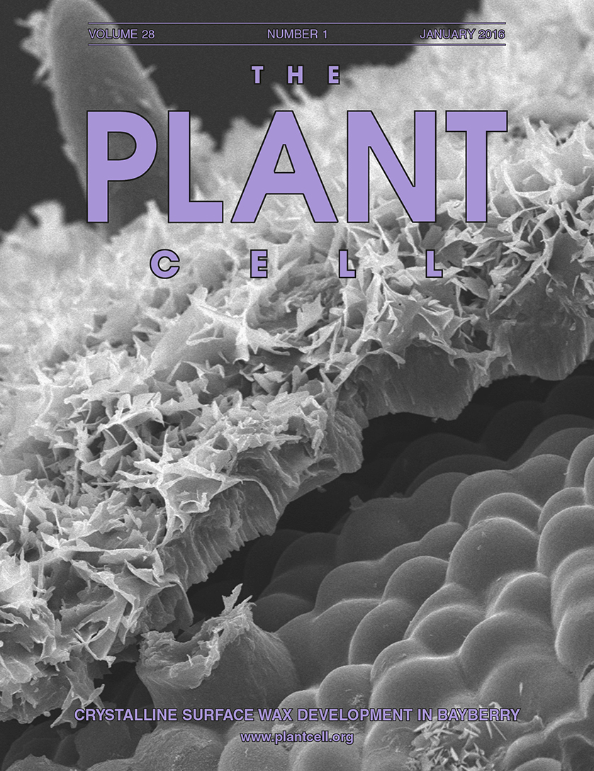
BRC Science Highlight
A Novel Lipid Pathway is Responsible for the Massive Quantity of Surface Wax on Bayberry Fruit
Objective To discover how Bayberry achieves the highest level of surface lipid known in nature
Approach
Analyze morphological and chemical development of surface wax
Monitor wax biosynthesis with [¹⁴C]-radiolabeling to determine mechanisms of synthesis
Use RNA-seq to identify highly expressed transcripts that may contribute to surface wax production
Propose a model for Bayberry wax biosynthesis
Result/Impacts
Extracellular glycerolipids in Bayberry wax are made by a novel triacylglycerol synthesis pathway
An increased understanding of this process may be useful in engineering plants for accumulation and secretion of high value lipids and other hydrocarbons
Simpson JP, Ohlrogge JB (2016) A Novel Pathway for Triacylglycerol Biosynthesis Is Responsible for the Accumulation of Massive Quantities of Glycerolipids in the Surface Wax of Bayberry (Myrica pensylvanica) Fruit. The Plant Cell 28, 248-264.
GLBRC February 2016

