Slide 1
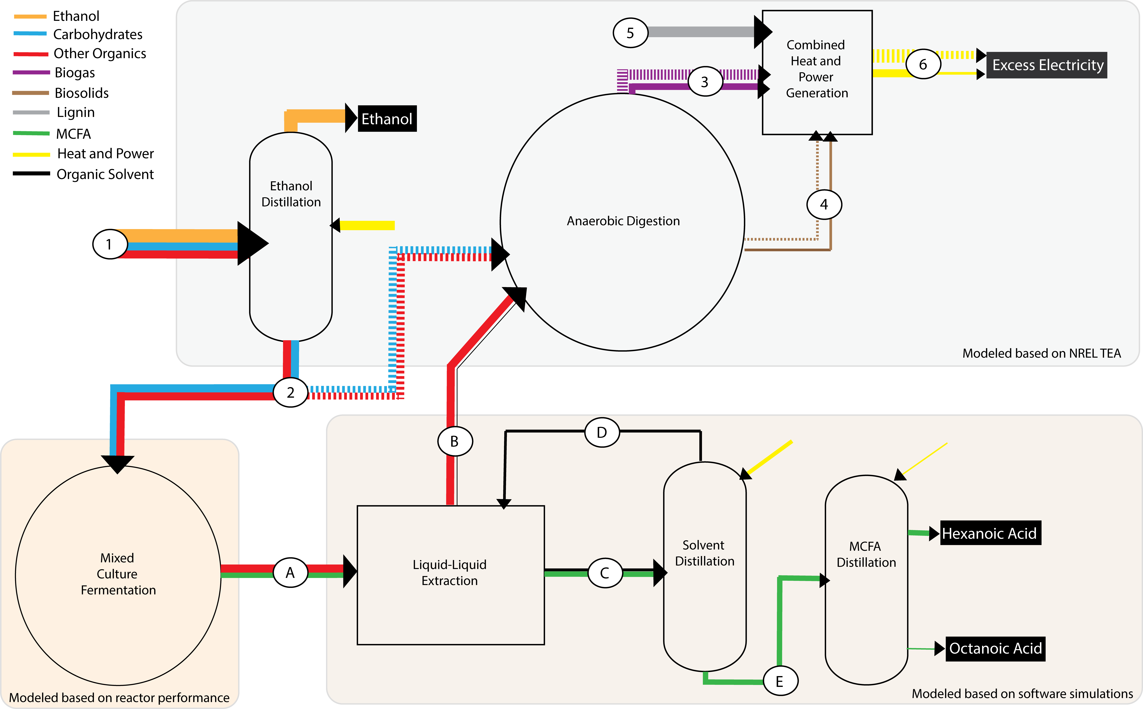
BRC Science Highlight
Lignocellulosic biomass conversion residue transformed into medium-chain fatty acid bioproducts
Objective Investigate the potential of improved lignocellulosic fuel production economics by producing valuable co-products, such as medium-chain fatty acids (MCFAs), from liquid conversion residue (i.e., stillage).
Approach
Test the hypothesis that a stillage-fed microbial community can sustain production of MCFAs.
Investigate the stability of the microbiome and potential roles of abundant community members in the MCFA-producing reactor.
Evaluate the techno-economics of producing MCFAs from ethanol stillage.
Results/Impacts
We developed conditions for sustained MCFA production by an anaerobic microbiome that uses stillage produced during lignocellulosic biorefining.
Techno-economic analyses, based on an industry-accepted model, demonstrated that valorizing lignocellulosic ethanol stillage to MCFAs could improve the economic sustainability of a biorefinery.
Energy balance through a proposed lignocellulosic biorefinery that simultaneously produces ethanol, electricity, and medium-chain fatty acids (MCFAs). Process streams include (1) fermented hydrolysate; (2) stillage; (3) biogas; (4) biosolids; (5) lignin; (6) heat and power; (A) fermented stillage; (B) aqueous phase; (C) organic phase; (D) organic solvent; and (E) MCFA.
Scarborough, M. J. et al. “Increasing the economic value of lignocellulosic stillage through medium-chain fatty acid production.” Biotechnology for Biofuels 11, 200 (2018) [DOI: 10.1186/s13068-018-1193-x].
GLBRC July 2018
Notes:
Notes:
text
Title again:
Text 1-2 sentence summary?

