Slide 1
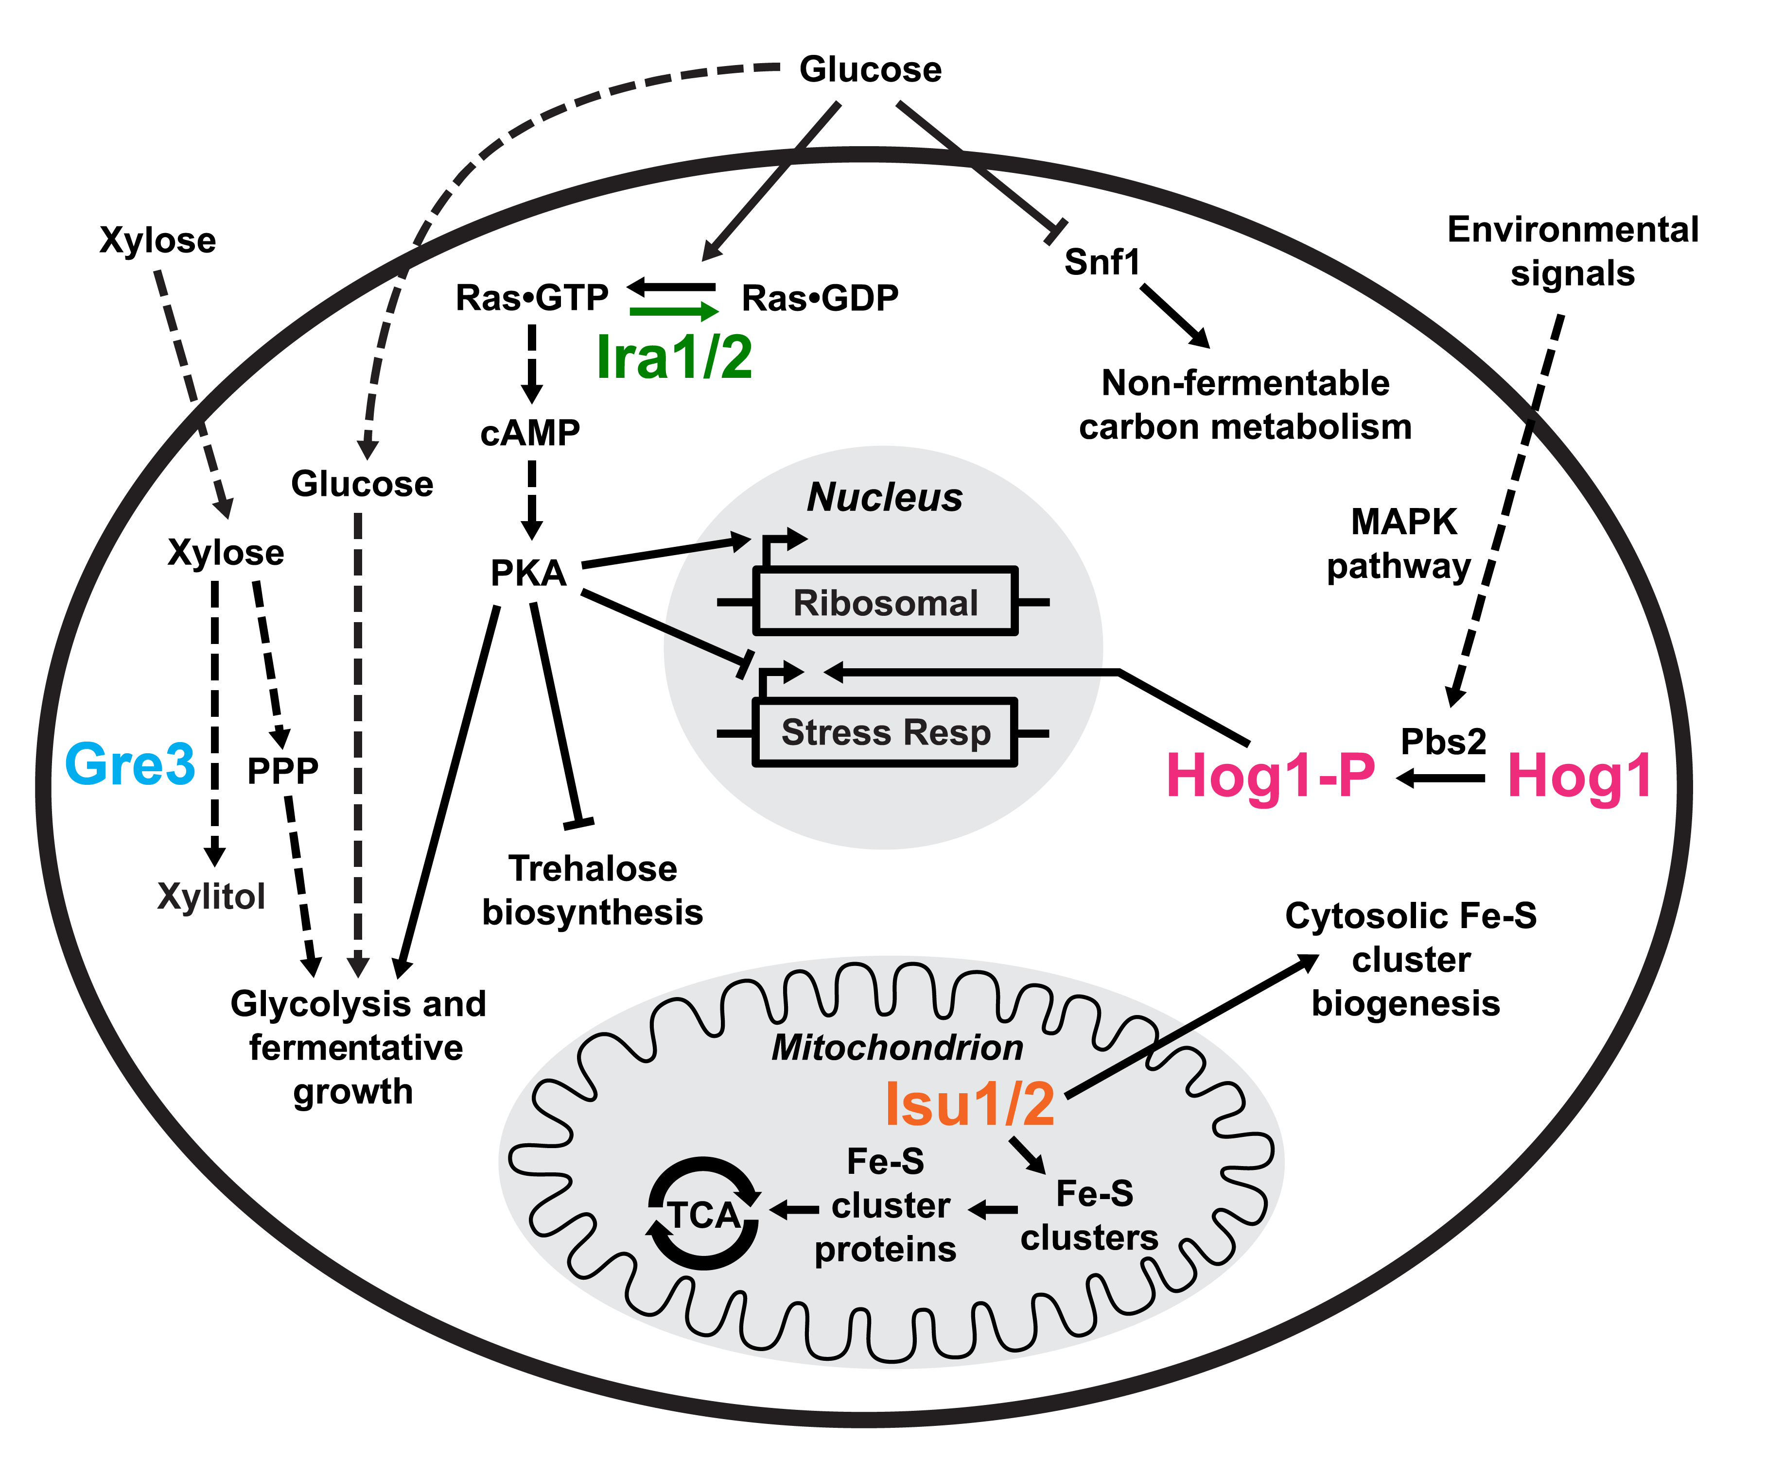
BRC Science Highlight
Yeast evolved for enhanced xylose utilization reveal interactions between cell signaling and Fe-S cluster biogenesis
Objective Obtain yeast strains that have enhanced xylose utilization and identify genetic determinants that contribute to the enhanced utilization
Approach
Saccharomyces cerevisiae was subjected to successive rounds of directed evolution, selecting for growth on xylose
Whole genome sequencing of evolved strains identified causative mutations and systems-level proteomic and metabolomic changes in response to xylose were analyzed
Result/Impacts
Rapid xylose utilization was found to be dependent upon genetic interactions among four genes, uncovering a surprising connection between Fe-S cluster assembly and cell signaling that facilitates aerobic respiration and anaerobic fermentation of xylose
Understanding how yeast cells adapt to non-preferential carbon sources uncovers potential genetic engineering strategies that can improve efficiency of biofuel production
Sato, T. K. et al. Directed evolution reveals unexpected epistatic interactions that alter metabolic regulation and enable anaerobic xylose use by Saccharomyces cerevisiae. PLOS Genetics (2016) [DOI: 10.1371/journal.pgen.1006372]
GLBRC October 2016
Notes:
Notes:
text
Title again:
Text 1-2 sentence summary?

