Slide 1
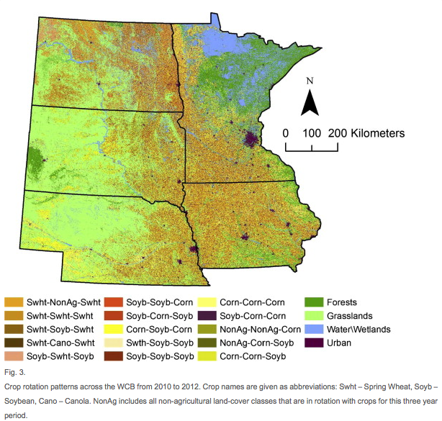
BRC Science Highlight
Identifying representative corn rotation patterns in the US Western Corn Belt
Objective To quantify the diversity of crop rotation patterns and examine land-cover transitions occurring in parts of the Western Corn Belt (WCB) via a novel algorithm applied over a specific time period.
Approach
Used the Representative Crop Rotations Using Edit Distance (RECRUIT) algorithm to identify representative crop rotations (RCR) in the WCB by studying multi-year data available from the Cropland Data Layer (CDL) database.
Result/Impacts
RECRUIT is capable of accounting for over 90% of the variability of the more than 13,000 rotations in the WCB using a small number (82) of RCRs; it can also detect pronounced shifts from grassland to monoculture corn/soybean cultivation. Furthermore, the area estimates of the RCRs are comparable to those obtained from agricultural census data.
RECRUIT can be a useful tool for providing input data to drive agro-ecosystem models and detect shifts in cropping patterns in response to environmental and socio-economic changes.
Sahajpal R, Zhang X, Izaurralde RC, Gelfand I, Hurtt GC. “Identifying representative crop rotation patterns and grassland loss in the US Western Corn Belt”. Computers and Electronics in Agriculture (2014) 173-182.
GLBRC March 2015
Notes:
Notes:
text
Title again:
Text 1-2 sentence summary?

