Slide 1
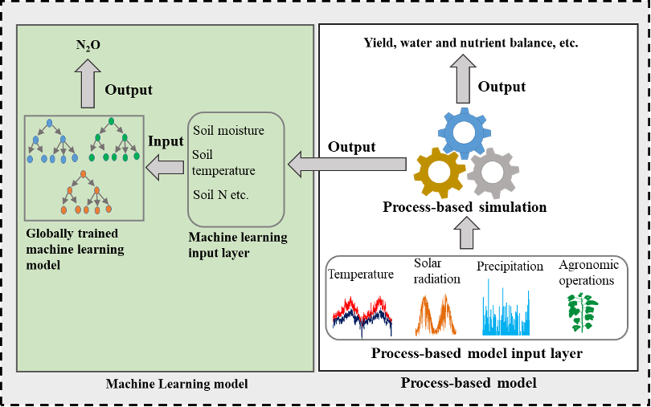
BRC Science Highlight
Machine learning improves predictions of agricultural nitrous oxide emissions
Objective Establish a machine learning model to better predict nitrous oxide emissions from agricultural soils.
Approach
Train the model to estimate N₂O emissions using six years of measurements from corn plots in the Upper Midwest.
Calibrate using inputs related to various soil, climate, and management scenarios.
Measure the model’s predictions of N₂O emissions alone, then coupled a separate model of nitrogen availability in the soil.
Result/Impacts
With relatively few input needs, the tool explained 38% of biweekly flux variance on test sites, improving to 51% when combined with a separate geospatial model used to determine nitrogen availability in the soil.
A machine learning system that is trained on thousands of actual measurements of agricultural nitrogen flux is paired with a model of soil nitrogen availability to better predict nitrous oxide emissions.
The approach can also aid scientists developing strategies – including the use of bioenergy crops and other practices – to mitigate these emissions.
Saha, D., Basso, B, and Robertson, G.P., “Machine learning improves predictions of agricultural nitrous oxide (N₂O) emissions from intensively managed cropping systems,” Environmental Research Letters 16, 2 (2021). [DOI: 10.1088/1748-9326/abd2f3]
GLBRC February 2021
Notes:
Notes:
text
Title again:
Text 1-2 sentence summary?

