Slide 1
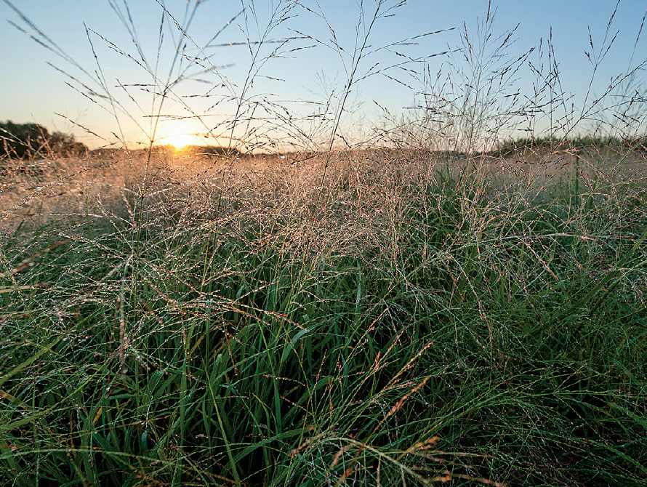
BRC Science Highlight
Cellulosic biofuel contributions to a sustainable energy future
Objective
To understand the environmental factors that affect the sustainability of biofuel crops and how appropriate crop, placement, and management choices can balance their tradeoffs.
Approach
We studied the sustainability of biofuel crops, including field production and management, plant-microbe interaction in the microbiome, biogeochemistry, biodiversity, economic and modeling stand point in a multi-year, multi-disciplinary effort across the Midwest.
Switchgrass, one of several cellulosic biofuel crops that provides ecosystem services associated with nitrogen and water conservation and biodiversity, especially when grown in species mixtures.
Result/Impacts
Major findings of this research include:
Perennial vegetation offers a higher net energy return on investment, greater soil C and N retention and improved insect and wildlife habitat compared to annual crops.
Biodiverse plantings provide ecosystem services such as pollination, pest protection and wildlife conservation that often benefit other cropland.
C debt generated by crop establishment can be minimized by avoiding tillage and lands with large C stores above ground (e.g. forests) or below ground (e.g. wetlands).
N fertilization can significantly affect the climate and water quality benefits of bioenergy crops if applied in excess of plant need and some crops require little if any supplemental N.
Food-fuel economic conflicts and C debt generated by indirect land use can be avoided by the use of marginal lands as well as the use of cover crops in annual cropping systems.
Economic incentives are needed for farmers to be willing to convert their lands to biofuel crop production.
Robertson, GP. et al. “Cellulosic Biofuel Contributions to a Sustainable Energy Future: Choices and Outcomes.” Science 356 (2017), [DOI: 10.1126/science.aal2324]
GLBRC June 2017

