Slide 1
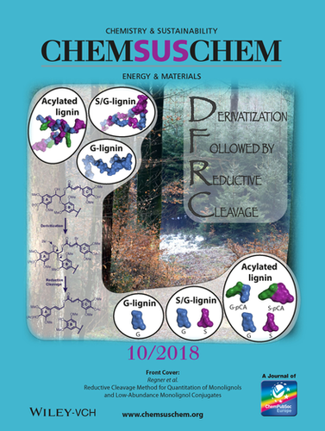
BRC Science Highlight
Optimized lignin analytics to improve biomass conversion efforts
Objective Reconstruct the derivatization followed by reductive cleavage (DFRC) protocol to yield an accurate and reproducible method for the quantification of releasable monolignols and monolignol conjugates from plant biomass.
Approach
With the DFRC method, use an array of synthetic β-ether γ-acylated model compounds to determine theoretical yields for all monolignol conjugates currently known to exist in lignin, and a newly synthesized set of deuterated analogs as internal standards for quantification by GC-MS/MS.
Demonstrate the superior sensitivity and accuracy of multiple-reaction-monitoring detection methods (in contrast to traditional selected-ion-monitoring).
Results/Impacts
Deconstructing and rebuilding the DFRC protocol has resulted in a robust method for lignin structural analysis.
Yield data have offered insight into mechanistic details.
Use of our isotopically labeled internal standards and cutting-edge analytics have improved sensitivity.
Data derived from our improved method will provide critical insight into the chemical structure of engineered lignins and how best to utilize them to produce valuable bioproducts.
Regner, M. et al. “Reductive cleavage method for quantitation of monolignols and low-abundance monolignol conjugates.” ChemSusChem 11(10), 1600-1605 (2018) [DOI: 10.1002/cssc.201800617].
GLBRC May 2018

