Slide 1
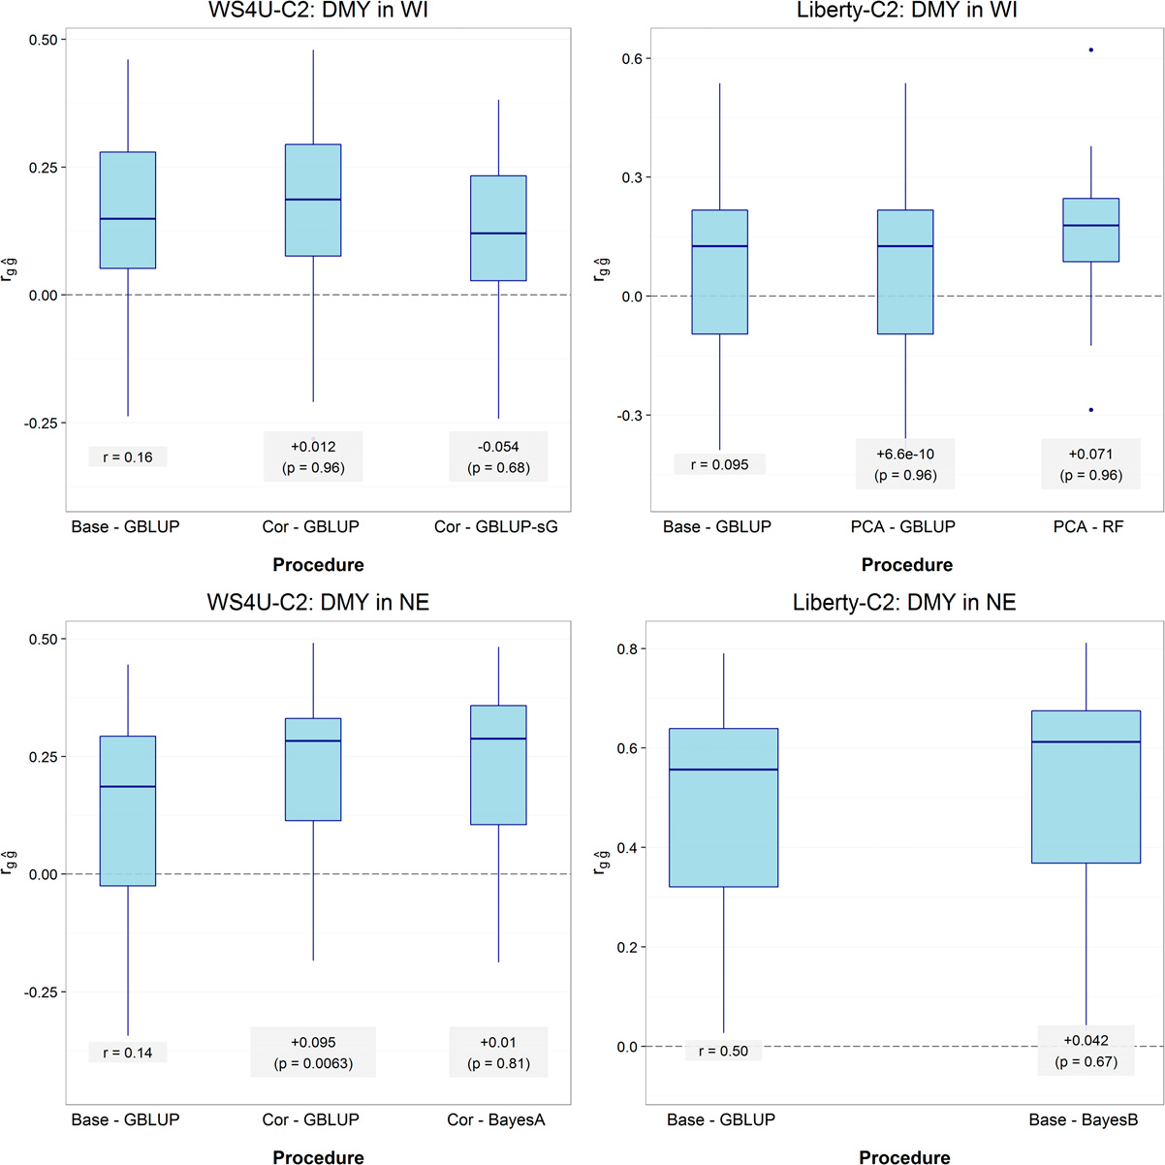
BRC Science Highlight
Improving Genomic Selection Prediction Accuracies for Switchgrass Breeding
Objective Empirically evaluate accuracies of different genomic prediction methods to assess the usefulness of genomic selection in switchgrass
Approach
Evaluate individuals genotyped by exome capture sequencing for three agronomic traits: biomass yield (DMY), plant height (PH), and heading date (HD)
Optimize genomic selection prediction procedures through four components: population learning scheme, environment learning scheme, marker-data transformation, and prediction model
Result/Impacts
Results suggest that marker-data transformations and, more generally, the account of linkage disequilibrium among markers, offer valuable opportunities for improving prediction procedures in genomic selection
High prediction accuracies, particularly with given traits at given locations, should motivate the implementation of genomic selection breeding programs in switchgrass and help accelerate the progress needed to reach biomass yield goals
$r_{g\hat{g}}$ (y-axis): estimated prediction accuracy
Ramstein, G.P. et al. “Accuracy of genomic prediction in switchgrass (Panicum virgatum L.) improved by accounting for linkage disequilibrium.” G3 6, 1049-1062 (2016) [DOI: 10.1534/g3.115.024950].
GLBRC June 2016
Notes:
Notes:
text
Title again:
Text 1-2 sentence summary?

