Slide 1
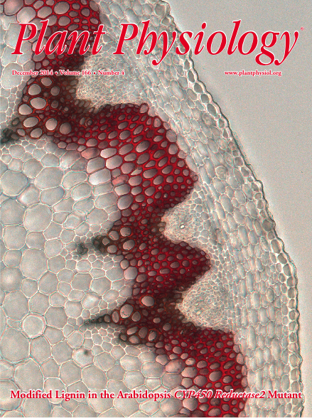
BRC Science Highlight
New Target for Engineering Lignin for Biofuel Production Identified
Objective To understand the control-points in lignification; to reduce the need for/cost of pretreatments by altering lignin content or composition in bioenergy feedstocks.
Approach
Microarray analysis and transcript profiling revealed ATR2 enzyme is co-expressed with lignin biosynthetic genes, unlike the other two CYP450 Reductace genes identified in Arabidopsis.
ATR2 expression was down regulated in T-DNA insertion mutants; phenotypic, metabolic, and structural differences were characterized.
Result/Impacts
Arabidopsis plants with atr2 mutations, while phenotypically normal, had increased glucose release following base pretreatment, compared to wild type. This results from altered lignin content and structure.
Results support the contention that ATR2 is involved in the lignin pathway and is thus a target for engineering plant cell walls that are better suited for biofuels applications.
Study suggests additional candidates in these pathways for future study.
Sundin L, Vanholme, R, Geerinck J, Goeminne G, Höfer R, Kim H, Ralph J, Boerjan W. Mutation of the Inducible ARABIDOPSIS THALIANA CYTOCHROME P450 REDUCTASE2 Alters Lignin Composition and Improves Saccharification Plant Physiol. 2014 166: 1956-1971. doi:10.1104/pp.114.245548
GLBRC December 2014
Notes:
Notes:
Plant cell walls contain polysaccharides that can be hydrolyzed into fermentable sugars. Lignin, which is also present in the cell walls, hinders enzymatic saccharification.
Lignin must be removed or cleaved, prior to saccharification, which requires chemicals and energy.
Altering lignin composition or structure can reduce the amount of effort needed to release glucose from cellulose thus increasing the economics of cellulosic biofuels production
New Target for Engineering Lignin for Biofuel Production Identified:
Plants cell walls contain polysaccharides that can be hydrolyzed into fermentable sugars. Lignin, which is also present in the cell walls, hinders enzymatic saccharification. Thus, lignin must be removed or cleaved prior to saccharification, which requires chemicals and energy and increases cellulosic biofuel production costs. Altering lignin composition or structure can reduce the amount of effort needed to release glucose from cellulose, thus increasing the economics of cellulosic biofuels production. GLBRC Researchers John Ralph and Hoon Kim and their colleagues at Ghent University and VIB (Flanders Institute of Biology) have a goal of understanding the control-points in the lignin pathway and identifying possible new engineering targets. The group’s December 2014 Plant Physiology Cover Article: Mutation of the Inducible ARABIDOPSIS THALIANA CYTOCHROME P450 REDUCTASE2 reports on the identification of a new target for engineering lignin for biofuel production. In the model plant Arabidopsis, there are three Cytochrome P450 Reductase genes. Microarray analysis and transcript profiling revealed that one of these three genes controls an enzyme (ATR2) that is co-expressed with lignin biosynthetic genes. By studying model plants in which the atr2 gene was down-regulated via T-DNA insertion, researchers found that, although phenotypically normal, the atr2 mutants had increased glucose release from cellulose following base pretreatment than the wild type. This increase in saccharification resulted from both altered lignin structure and altered lignin content. Their results support the contention that ATR2 is involved in the lignin pathway and is thus a target for engineering plant cell walls that are better suited for biofuels applications. The study also suggests additional candidates in the lignin pathway for future study.

