Slide 1
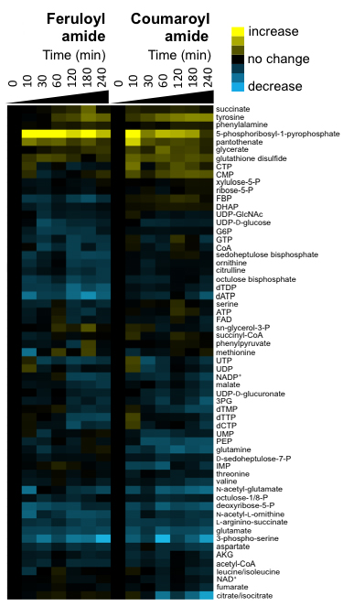
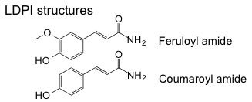
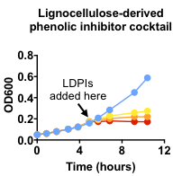
BRC Science Highlight
Phenolic amides inhibit de novo nucleotide biosynthesis
Objective To determine the mechanism by which amide inhibitors, present in ammonia pre-treated hydrolysates, inhibit growth and sugar utilization in the model organism Escherichia coli. Knowledge of the mechanisms of inhibition will enable more efficient fermentative and bioconversion processes.
Approach
Utilized metabolomics, isotopic tracer methods, and biochemical assays to identify the cause of inhibitor-mediated growth inhibition and identify where blocks in metabolism occur.
Result/Impacts
Phenolic amides are potent inhibitors of purine and pyrimidine nucleotide biosynthetic pathways, resulting in accumulation of a key biosynthetic precursor (PRPP), a long-term generalized decrease in nucleotide pools, and greatly reduced flux of carbon and nitrogen into nucleotides.
Inhibitor effects are mediated by direct inhibition of glutamine amidotransferases, enzymes that function in nucleotide biosynthetic pathways; the effects of the amides are reversed by supplementation with nucleosides, which can be assimilated via salvage pathways.
Knowledge of the mechanistic effects of hydrolysate inhibitors will inform efforts to engineer new biocatalysts with improved bioconversion efficiencies.
Pisithkul, T. et al. 2015. Phenolic amides are potent inhibitors of de novo nucleotide biosynthesis. Applied and Environmental Microbiology 10.1128/AEM.01324-15.
GLBRC July 2015
Notes:
Notes:
text
Title again:
Text 1-2 sentence summary?

