Slide 1

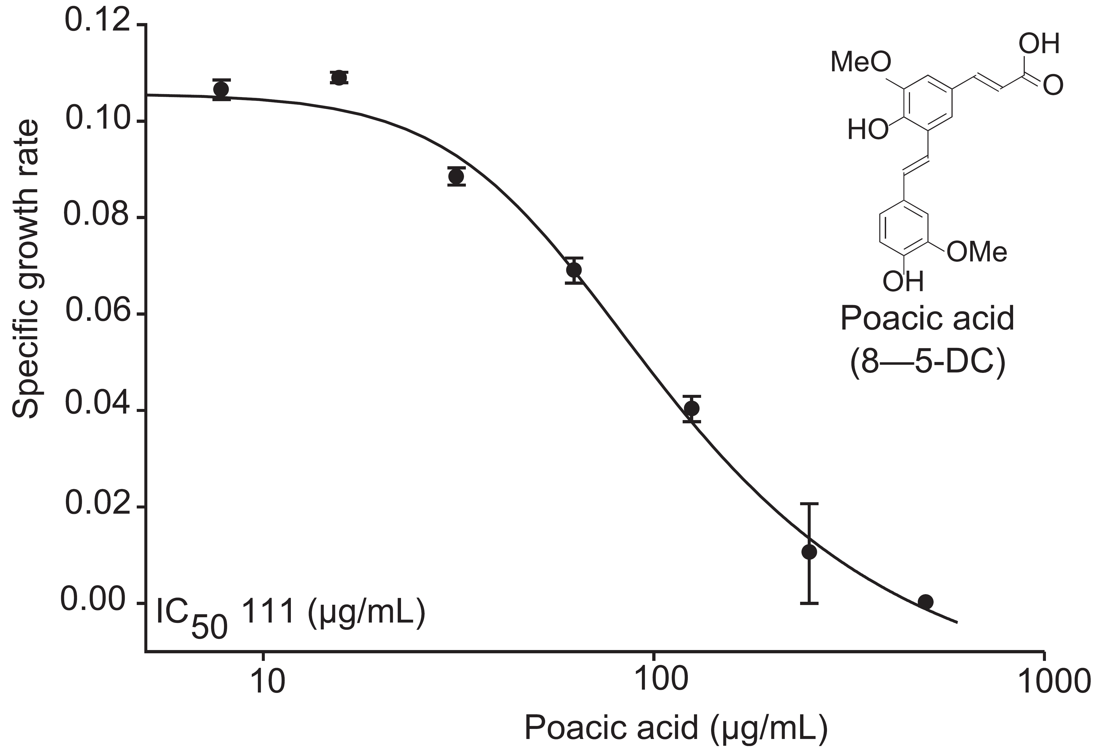
BRC Science Highlight
Biofuels research uncovers a natural fungicide
Objective
Plant derived fermentation inhibitors are a challenge to efficient biofuel production; however, they may also have added value as novel antibiotics. A new antifungal agent was discovered from a set of poorly studied lignin derivatives, diferulates.
Poacic acid inhibits fungal cell wall biogenesis and causes abnormal cell morphology
Approach
A combination of yeast chemical genomic and microscopic profiling was used to identify the cellular target of the diferulate poacic acid.
The activity of this agent was tested against economically significant plant pathogens
Result/Impacts
Poacic acid represents a novel agent specifically targeting the glucan layer in both fungal and oomycete cell walls
As a plant-derived agent, it has potential value as a new antifungal agent in organic and conventional agriculture.
https://www.glbrc.org/news/biofuels-research-uncovers-natural-fungicide
Poacic acid inhibits the oomycete
Phytophthora sojae
Piotrowski JS, Okada H, Lu F, Li S, Hinchman L, Ranjan A, Smith D, Higbee A, Ulbrich A, Coon J, Deshpande R, Bukhman Y, McIlwain S, Ong I, Landick R, Boone C, Ralph J, Myers C, Kabbage M, Ohya Y. 2015. The plant derived antifungal agent poacic acid targets β-1,3-glucan. Proceedings of the National Academy of Sciences 112, E1490-1497
GLBRC April 2015
Notes:
Notes:
text
Title again:
Text 1-2 sentence summary?

