Slide 1
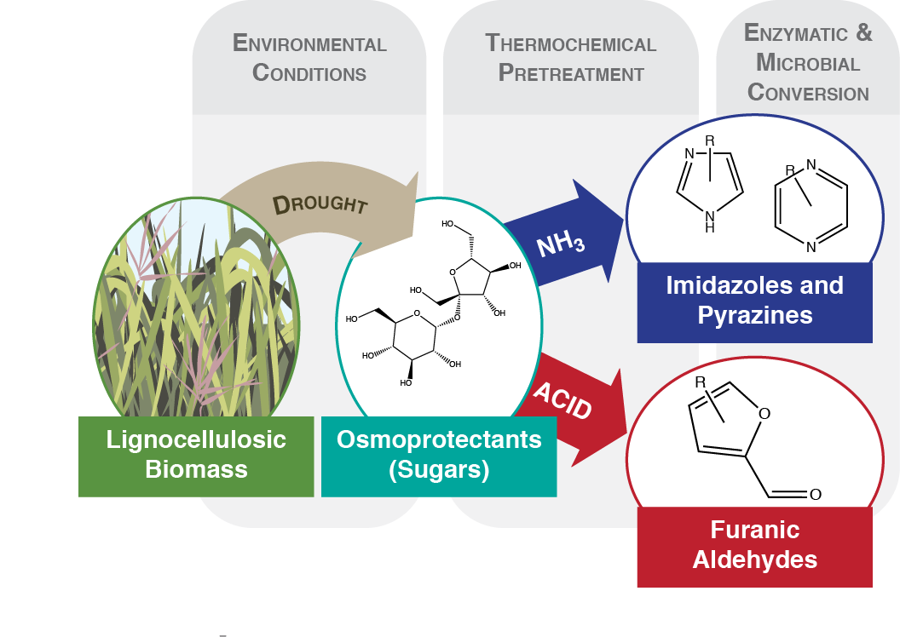
BRC Science Highlight
Inhibition of microbial biofuel production in drought stressed switchgrass hydrolysate
Objective While the effects of variable weather on biomass yield are well documented, the impacts on downstream processes remain unexplored. This study examines how interannual variability in precipitation impacts hydrolysate chemical composition and biofuel production by microbial catalysts.
Approach
We collected corn stover and switchgrass samples during three years: a major drought year and two years with average precipitation over the entire season.
We deconstructued biomass via ammonia-based pretreatment and enzymatic hydrolysis, analyzed chemical compositions of hydrolysates, and assessed microbial fermentative performance.
Result/Impacts
Growth of yeast was completely inhibited in hydrolysate made from drought stressed switchgrass and contained elevated levels of pyrazines and imidazoles
Environmental variation can have significant effects on biomass hydrolysate properties. Knowledge of how these factors impact biofuel production can guide pretreatment and biocatalyst choices to mitigate these inhibitory effects.
Ong, R. G. et al. Inhibition of microbial biofuel production in drought stressed switchgrass hydrolysate. Biotechnology for Biofuels (2016) DOI: 10.1186/s13068-016-0657-0
GLBRC November 2016
Notes:
Notes:
text
Title again:
Text 1-2 sentence summary?

