Slide 1
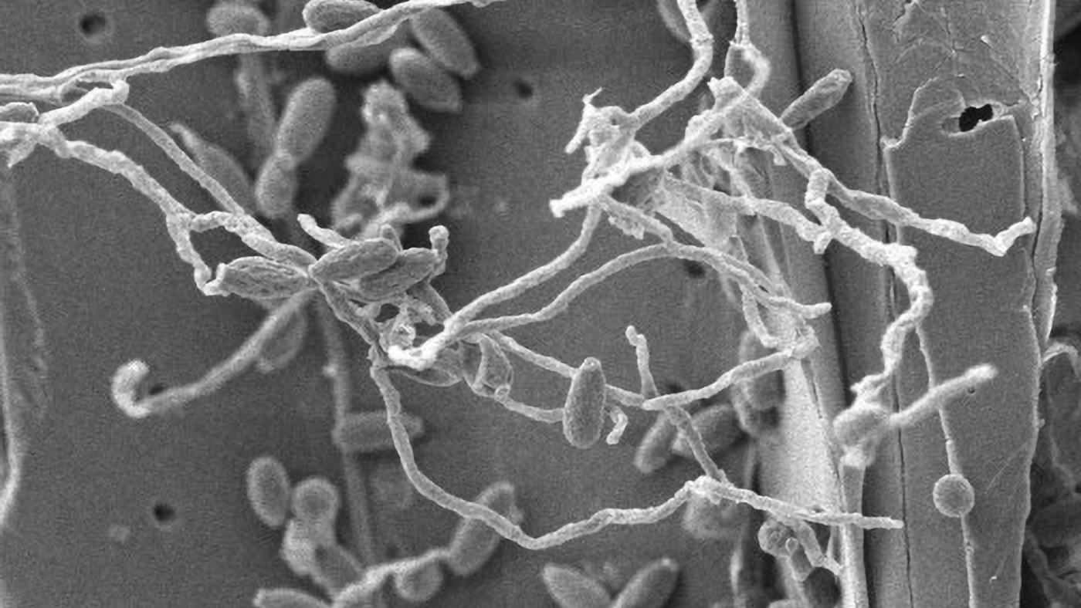
BRC Science Highlight
Fungus yields a new biomass-digesting enzyme
Objective Characterize lignin-degrading activity found in a wheat straw composting community to search for new enzymes.
Approach
Isolate a highly effective lignocellulose-degrading fungus.
Multi-omics analysis to identify cellulose-degrading enzymes.
An electron micrograph of the fungus Parascedosporium putredinis NO1 growing on wheat straw. Credit: Nicola Oates, University of York
Result/Impacts
A soft-rot fungus from the genus Parascedosporium showed robust enzyme activity and the ability to break down lignocellulose.
A new oxidase was identified that effectively cleaved the most common interunit bond in lignin, the β-O-4 ether bond, without the need for any cofactor.
Pretreatment of wheat straw with the oxidase enhanced the material’s digestibility by other cellulases, resulting in a 20% increase in the amount of glucose released compared to a control treatment.
The oxidase also released lignocellulosic co-products with potential pharmaceutical and industrial value, which may improve the economics of biorefining.
Oates, N.C., Abood, A., Schirmacher, A.M., Alessi, A.M., Bird, S.M., Bennett, J.P., Leadbeater, D.R., Li, Y., Dowle, A.A., Liu, S., Tymokhin, V.I., Ralph, J., McQueen-Mason, S.J., Bruce, N.C., “A multi-omics approach to lignocellulolytic enzyme discovery reveals a new ligninase activity from Parascedosporium putredinis N01.” Proceedings of the National Academy of Sciences 118, e2008888118 (2021) [DOI: 10.1073/pnas.2008888118]
GLBRC June 2021
Notes:
Notes:
text
Title again:
Text 1-2 sentence summary?

