Slide 1
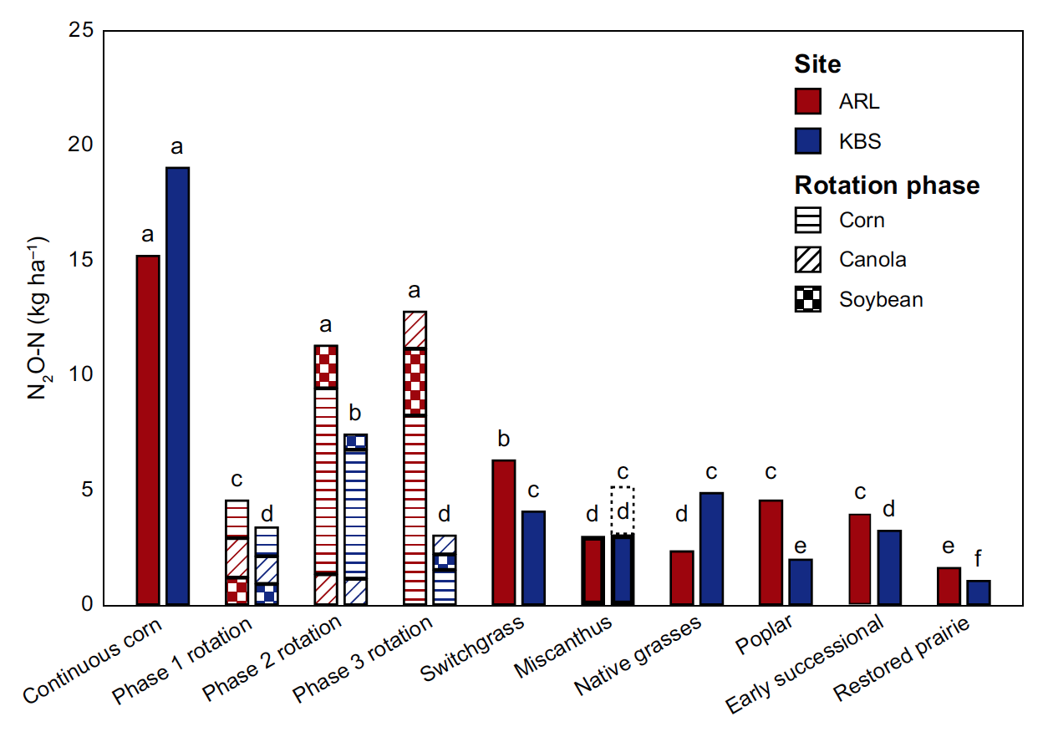
BRC Science Highlight
N₂O emissions during establishment phase of various bioenergy cropping systems
Objective To understand the nitrous oxide (N₂O) emissions of likely biofuel feedstocks during the establishment phase, which will be a key component of sustainability evaluation of bioenergy cropping systems.
Approach
Measured soil N₂O emissions from a 3-yr establishment-phase bioenergy cropping systems experiment replicated in south-central WI and southwestern MI.
Cropping systems were annual monocultures (continuous corn, corn-soybean-canola rotation), perennial monocultures (switchgrass, miscanthus, poplar), and perennial polycultures (native grass mixture, early successional community, restored prairie).
Cumulative 2009-2011 N₂O fluxes from various bioenergy crops
Result/Impacts
Emissions ranged from 3.1-19.1 kgN₂O-N/ha yr for annuals (continuous corn > corn-soybean-canola) and 1.1-6.3 kgN₂O-N/ha yr for perennials, with N₂O peak fluxes being associated with rain after fertilization.
Models trained on single systems performed well in most monocultures but worse in polyclutures, which means simulation models including N₂O emissions should be parameterized specifically for particular plant systems.
During establishment phase, perennial bioenergy crops emit less N₂O than annual crops, especially when not fertilized.
Oates, L. G., Duncan, D. S., Gelfand, I., Millar, N., Robertson, G. P. and Jackson, R. D. (2015), Nitrous oxide emissions during establishment of eight alternative cellulosic bioenergy cropping systems in the North Central United States. GCB Bioenergy. doi: 10.1111/gcbb.12268
GLBRC May 2015
Notes:
Notes:
text
Title again:
Text 1-2 sentence summary?

