Slide 1
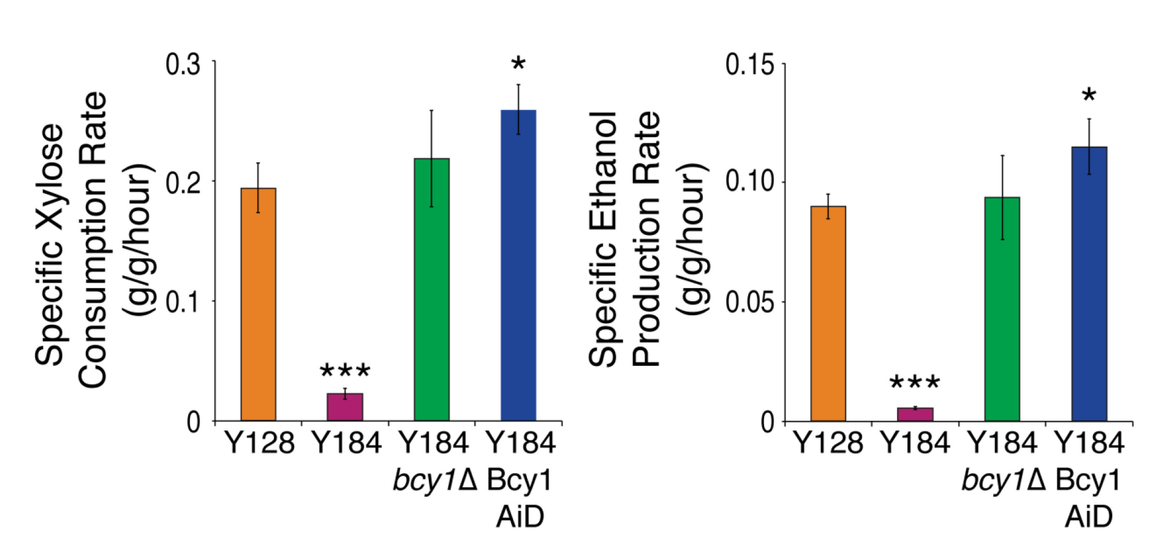
BRC Science Highlight
Xylose fermentation by yeast requires rewired cellular signaling
Objective
Explore the metabolic and regulatory mechanisms required for anaerobic fermentation of xylose.
Approach
Investigated lab-evolved yeast strains with varying abilities to use xylose in order to explore physiological mechanisms that enable anaerobic xylose metabolism.
Applied comparative systems biology approaches to identify transcript, protein, and phosphorylation differences that correlate with xylose consumption.
Used a novel network analysis to infer the regulatory networks most likely to mediate observed phosphorylation differences.
Specific rates of xylose consumption (left) and ethanol production (right) show that perturbation of PKA signaling through deletion (bcy1Δ) or peptide-tagging (Bcy1 AiD) of the PKA inhibitor BCY1 improves anaerobic xylose fermentation in yeast compared to the parent strain Y184. Asterisks denote significant differences relative to the evolved, xylose-utilizing strain Y128. (* p < 0.05, *** p < .001)
Results/Impacts
A host of regulatory changes appears to be required for anaerobic xylose fermentation, with multiple physiological effects combining to drive the phenotype.
Different routes of protein kinase A (PKA) activation can lead to distinct outcomes, including the decoupling of traditionally linked cellular functions such as growth and metabolism.
Efforts to engineer biofuel-producing microbes must consider the broader regulatory context of microbial metabolism to drive desired pathways while minimizing off-target effects.
K. S. Myers, et al. “Rewired cellular signaling coordinates sugar and hypoxic responses for anaerobic xylose fermentation in yeast .” PLoS Genetics 15, e1008037 (2019). 10.1371/journal.pgen.1008037
GLBRC March 2019

