Slide 1
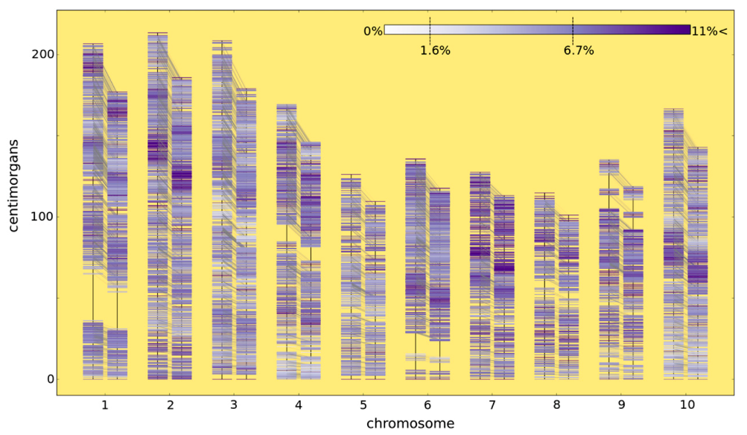
BRC Science Highlight
Making Genetic Maps More Accurate
Objective More accurate estimation of genetic linkage by incorporating non-Mendelian retention of heterozygosity in plant recombinant inbred lines.
Approach
Adapted existing genetic model to include
non-Mendelian maintenance of heterozygote loci.
Solved for a new general solution for expected genotype probabilities based on observed levels of heterozygosity.
Reported efficacy of genetic model for a simulated recombinant inbred population and a sorghum mapping population that have excess heterozygosity.
Result/Impacts
Revised model allows for (1) more accurate genetic map generation and (2) retention of more genetic information.
Improved accuracy of methods (e.g. marker assisted selection, QTL mapping, map-based cloning) that rely on estimations of recombination events.
Code and examples made available for public use and further improvements.
Truong SK, McCormick RF, Morishige DT, Mullet JE (2014) Resolution of genetic map expansion caused by excess heterozygosity in plant recombinant inbred populations. G3 (Bethesda) 4: 1963-1969
GLBRC February 2015
Notes:
Notes:
text
Title again:
Text 1-2 sentence summary?

