Slide 1
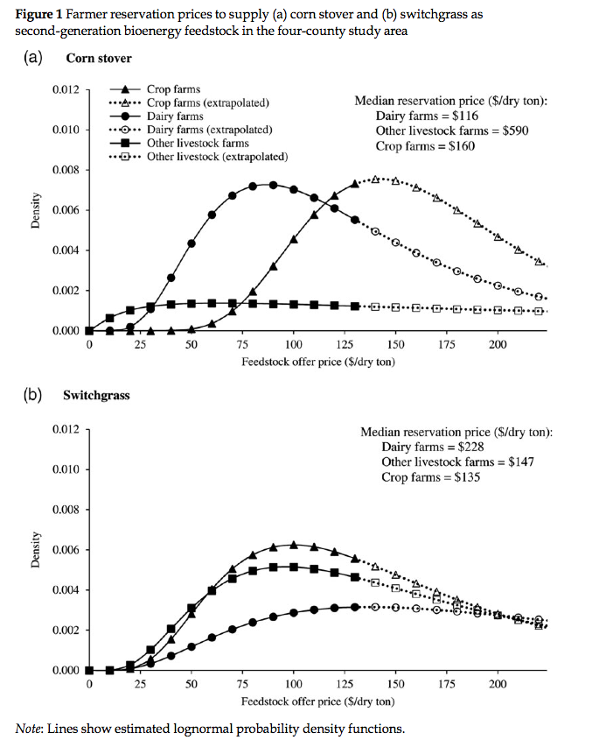
BRC Science Highlight
Farm supply response for bioenergy feedstocks in the Midwest
Objective To analyze farm supply responses for corn stover and switchgrass in Wisconsin and understand what social and environmental factors motivate farmers, in addition to profit, to choose particular feedstocks
Approach
Surveys were sent out to farmers that would get information regarding boundary values for feedstock supply prices
The ex-ante particular model uses those boundary values and predicts the proportion of farms to supply a feedstock at a given price and the share of land that could be dedicated to that feedstock at that given price
Result/Impacts
There is heterogeneity in price within and across farm types in the studied area
Across all farm types, there is a relatively low proportion of farmers willing to supply either feedstock even at higher prices (<15-40% depending on the feedstock). This means that even at higher prices offered, there would be relatively small land areas allocated to bioenergy feedstocks
Mooney DF, Barham BL, and Liang C. “Inelastic and Fragmented Farm Supply Response for Second-generation Bioenergy Feedstocks: Ex Ante Survey Evidence from Wisconsin”. Applied Economic Perspectives and Policy (2014). doi:10.1093/aepp/ppu033
GLBRC December 2014
Notes:
Notes:
text
Title again:
Text 1-2 sentence summary?

