Slide 1
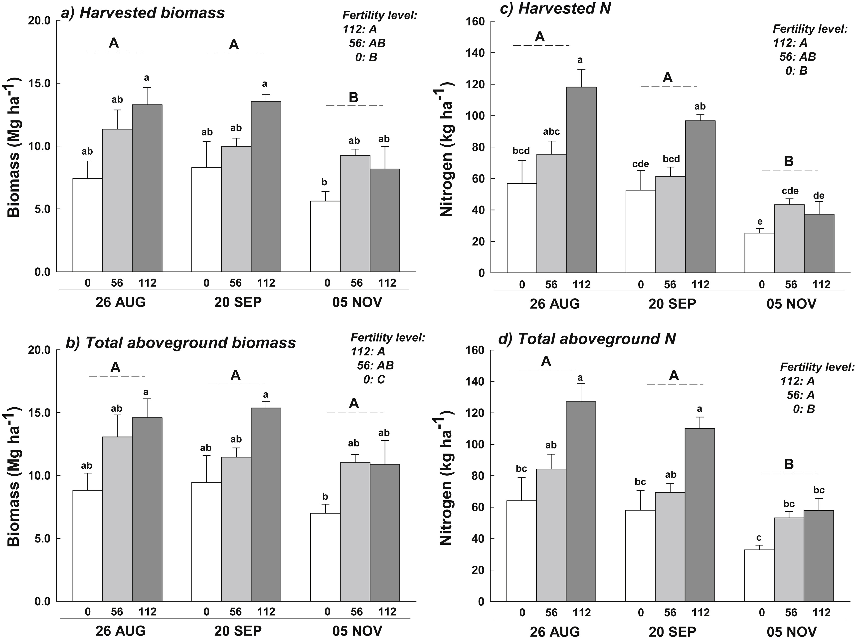
BRC Science Highlight
Distribution of switchgrass aboveground biomass in response to N addition and harvest dates
Objective
To understand within-season biomass loss in switchgrass and identify plant components that contribute to nitrogen (N) loss or retention at different harvest times.
Approach
Studied two sites in Wisconsin.
Compared mechanical- and hand-harvested switchgrass to understand yield loss associated with field operations.
Tracked biomass and N-allocation in different plant parts over time using 1) three levels of N additions and 2) four farm locations in hand-harvested plots.
Harvested (a) and total aboveground (b) biomass (Mg ha⁻¹), and nitrogen mass (kg ha⁻¹) in harvested (c) and total aboveground (d) biomass, by harvest date for switchgrass monocultures.
Result/Impacts
Harvested yields decreased over successive harvest dates as a result of the physical loss of leaves and inflorescence biomass (biomass that starts flowering)(panel a).
Although N addition increased total aboveground biomass, it also increased the proportion of biomass occurring as leaves and inflorescence)(panel b). Leaf and inflorescence biomass decreased over time and during harvest operations; however, this biomass became incorporated into the litter pool and increased on-site N retention (panels c and d).
Understanding biomass loss over time and identifying plant components that contribute to N loss or retention at different harvest dates can help farmers identify better N amendment and harvest management practices
Miesel, J.R. et al. “Distribution of switchgrass (Panicum virgatum L.) aboveground biomass in response to nitrogen addition and across harvest dates.” Biomass and Bioenergy 100, 74-83 (2017) DOI: 10.1016/j.biombioe.2017.03.012
GLBRC April 2017

