Slide 1
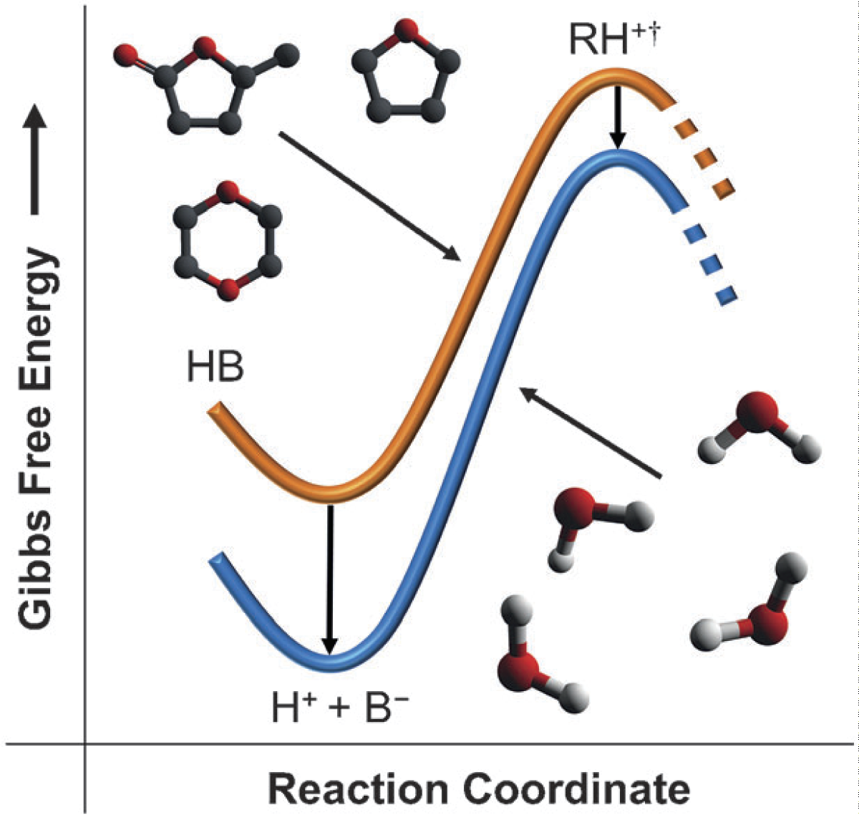
BRC Science Highlight
Mechanism for Increased Reaction Rate of Acid-Catalyzed Biomass Conversion in GVL solvent
Objective To determine how polar solvents such as gamma-valerolactone (GVL) affect the kinetics of biomass sugar conversion in acid-catalyzed reactions.
Approach
Dehydration of xylose to furfural was used as a probe reaction to study the effects of GVL vs. water as a solvent on the kinetic parameters for acid-catalyzed conversion.
Turn over frequencies (TOF) of xylose to furfural conversion were calculated using acid catalysts with varying pKa values.
Result/Impacts
A significant increase in reaction rate and product selectivity was observed for acid-catalyzed reactions utilizing GVL as compared to water.
Polar solvents appear to stabilize the protonated transition state intermediate, favoring the energetics of product formation.
GVL has similar effects on acid-catalyzed hydrolysis of cellobiose to glucose, indicating that the solvent properties are not specific to xylose.
Mellmer M. A. et. al. 2014. Solvent Effects in Acid-Catalyzed Biomass Conversion Reactions. Angewandte Chemie, 53 (44), 11872-11875.
GLBRC January 2015
Notes:
Notes:
text
Title again:
Text 1-2 sentence summary?

