Slide 1
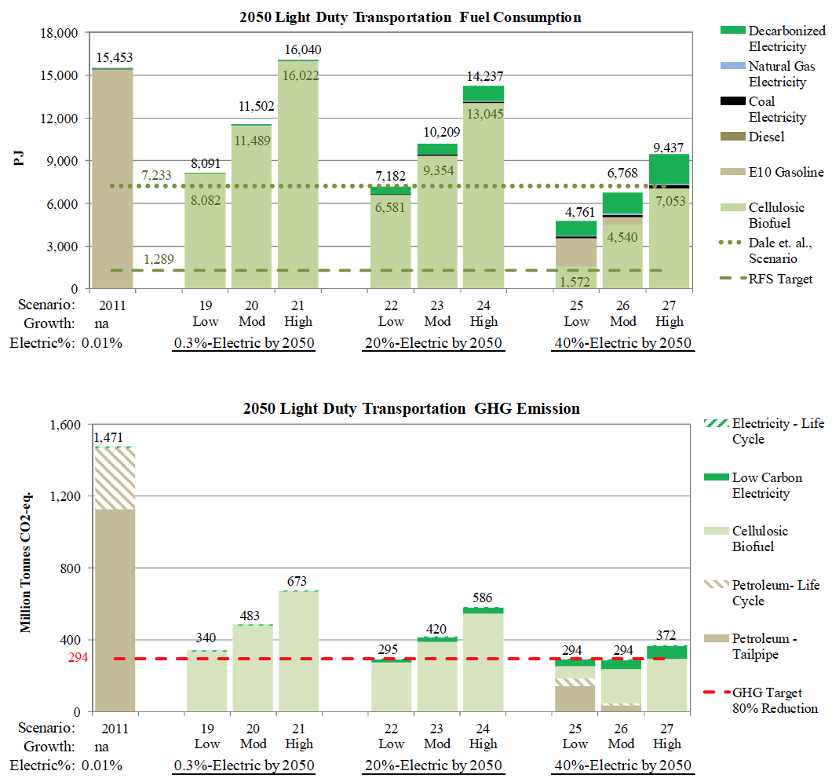
BRC Science Highlight
Potential for electrified vehicles to contribute to petroleum and climate goals and implications for biofuels
Objective To study the extent to which electrified vehicles could reduce petroleum consumption and GHG emissions.
Approach
Examined petroleum consumption and GHG sensitivity via 27 scenarios which included:
Reference scenarios, which assumed no change to GHG intensity from current levels
Petroleum-targeted scenarios, which assumed that electricity supply is decarbonized by 40% (which assumes most of the light duty vehicles are hybrid or plug-in hybrid).
Climate-targeted scenarios, which assumed that electricity supply is decarbonized by 80%
Result/Impacts
With high rates of electrification (40% of miles traveled), the petroleum-reduction benchmark could be satisfied, even with high travel demand growth.
However, those same scenarios could not satisfy 80% of GHG-reduction targets, even assuming 80% decarbonized electricity
At a relatively high rate of electrification (40% of miles and 24% by fuel), an 80% GHG reduction could only be achieved with significant quantities of low-carbon liquid fuel in cases with low or moderate travel growth.
Meijer, P.J. et. al. 2015. The Potential for Electrified Vehicles to Contribute to U.S. Petroleum and Climate Goals and Implications for Advanced Biofuels. Environmental Science & Technology, doi: 10.1021/acs.est.5b01691.

