Slide 1
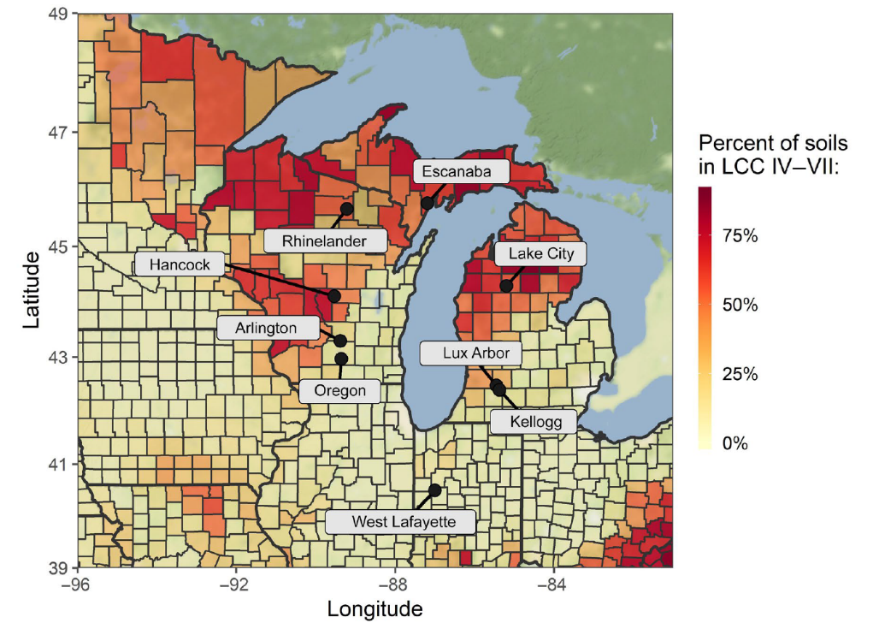
BRC Science Highlight
Land-use model shows planting switchgrass can increase soil carbon on non-agricultural land
Objective Model changes in soil organic carbon in switchgrass plots on marginal lands, taking into account soil differences, three climate change scenarios, and adaptation techniques.
Approach
Develop a model that predicts changes in soil organic carbon with varying climate, soils and mitigation practices across the Upper Midwest.
Simulate 20 years of switchgrass growth in 9 sites under three climate scenarios: atmospheric CO₂ levels of 450 ppm (sustainability), 590 ppm (middle-of-the-road), and 950 ppm (high).
Soil organic carbon levels were simulated in eight sites with varying climates and soil quality across the Great Lakes Region.
Result/Impacts
Over 20 years of simulated growth, switchgrass added an average of 0.87 Mg C ha⁻¹ year⁻¹ to the soil, with ranges of 0.2-1.3 Mg C ha⁻¹ year⁻¹ depending on the climate and soil type.
The “high emission” scenario resulted in the lowest range of carbon stored.
Planting switchgrass varieties with longer growing cycle mitigated >60% reductions of soil carbon stemming from climate change.
Martinez-Feria, R. and Basso, B., “Predicting soil carbon changes in switchgrass grown on marginal lands under climate change and adaptation strategies,” GCB Bioenergy 12, 742-755 (2020). [DOI: 10.1111/gcbb.12726]
GLBRC August 2020
Notes:
Notes:
text
Title again:
Text 1-2 sentence summary?

