Slide 1
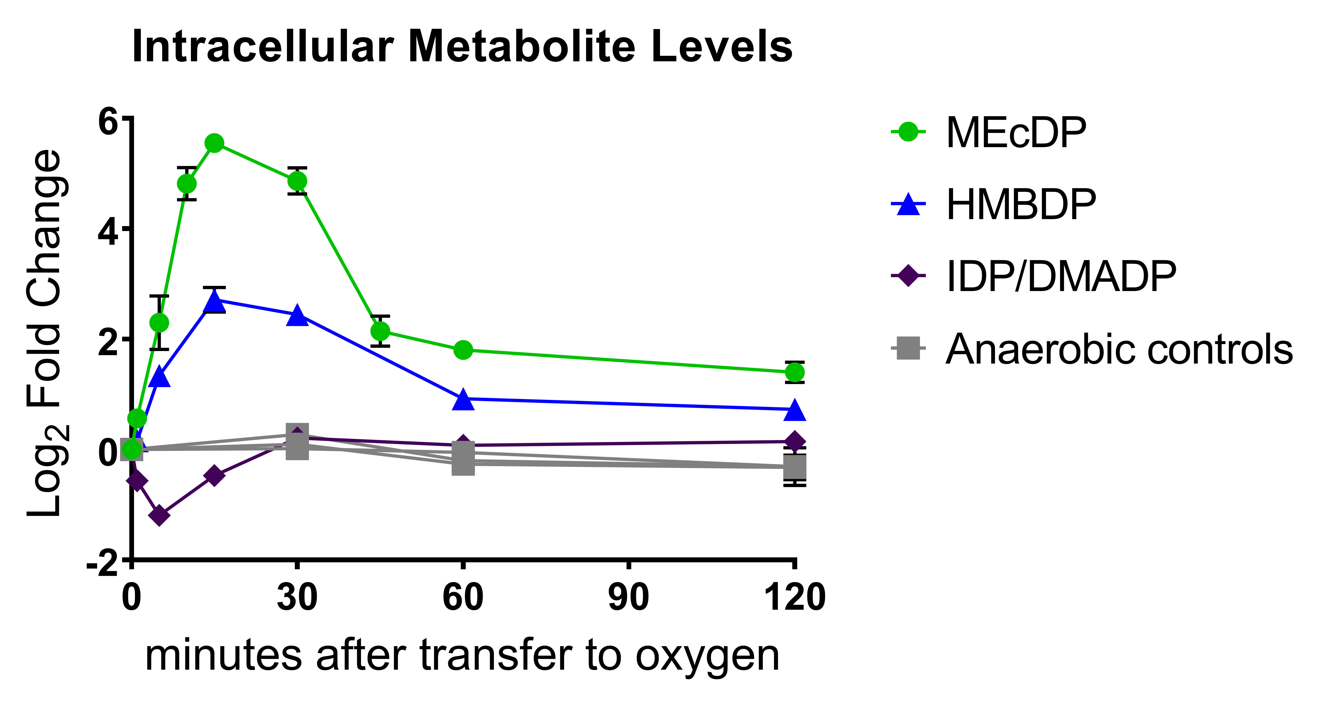
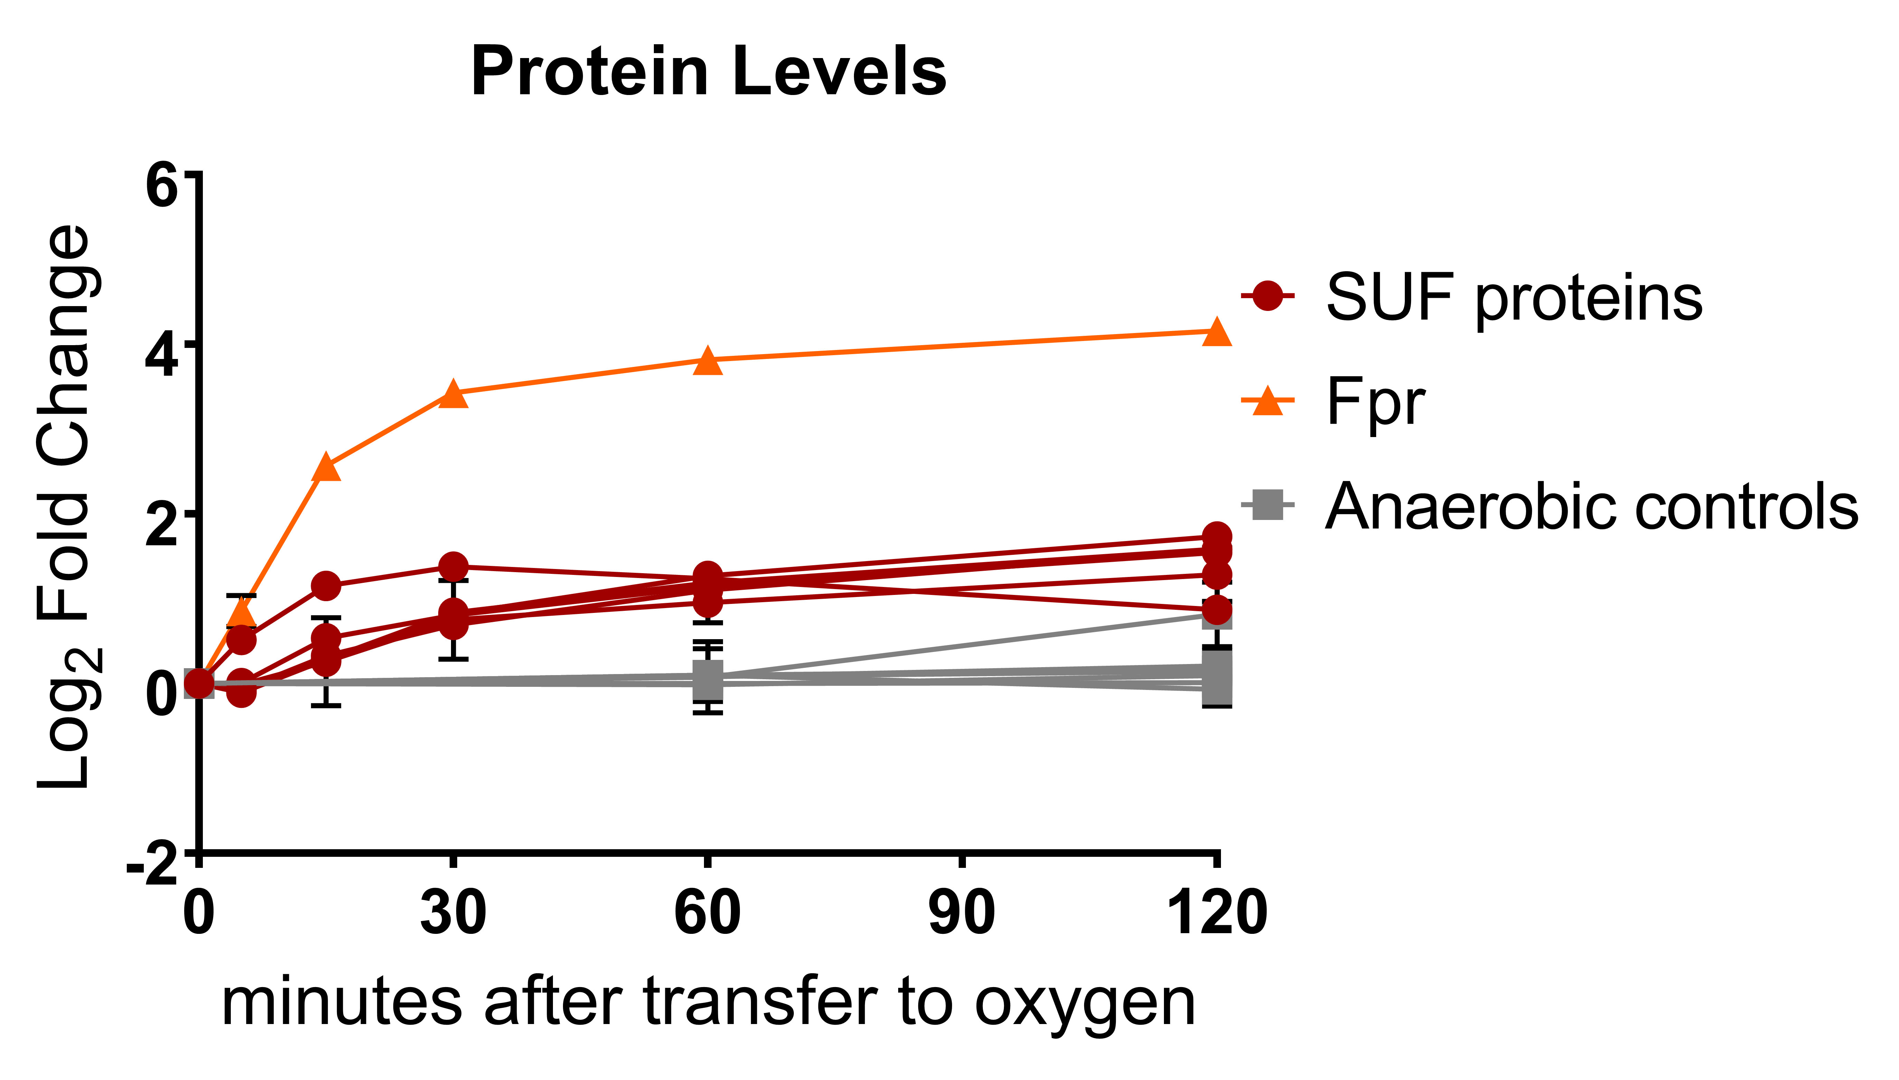
BRC Science Highlight
Microbial stress responses may guide efforts to engineer bioproduct synthesis
Objective
Investigate how the prolific ethanol-producing microbe Zymomonas mobilis regulates carbon flux into isoprenoid synthesis.
Approach
Exposed Z. mobilis to oxygen to disrupt the iron-sulfur cofactor necessary for the rate-limiting step in isoprenoid synthesis through the methyl erythritol-4-phosphate (MEP) pathway.
Assessed changes in enzyme expression that allowed the microbe to overcome the induced MEP bottleneck and drive more carbon into isoprenoid production.
Results/Impacts
Z. mobilis resolved the bottleneck almost completely within an hour through upregulation of a relatively small number of enzymes, including several involved in the formation and maintenance of the iron-sulfur cluster.
After oxygen exposure, rapid changes in Z. mobilis MEP pathway intermediates (top) correlate with increased expression of flavodoxin reductase (Fpr) and SUF operon enzymes (bottom).
Results suggest that Z. mobilis has the capacity to shunt much more carbon through the MEP biosynthesis pathway than it does under normal anaerobic conditions, using a small number of regulatory changes.
Enzymes used to maintain iron-sulfur cluster activity may be good targets for metabolic engineering to increase microbial production of isoprenoids.
J. I. Martien, et al. “Systems-Level Analysis of Oxygen Exposure in Zymomonas mobilis: Implications for Isoprenoid Production.” mSystems 4, e00284-18 (2019). 10.1128/mSystems.00284-18
GLBRC March 2019

