Slide 1
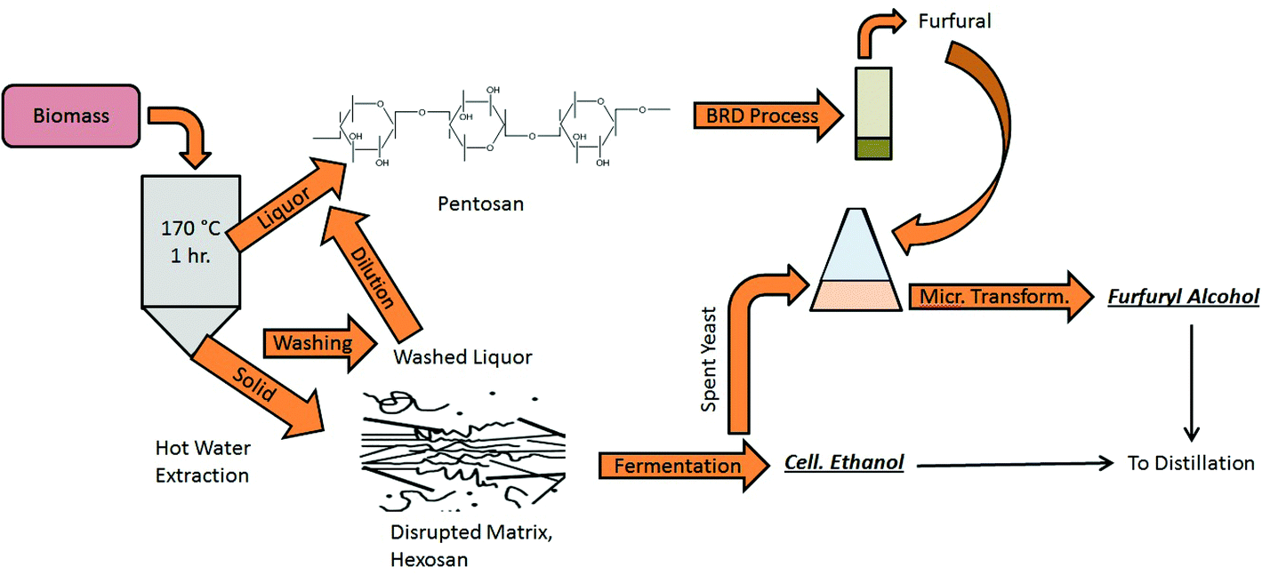
BRC Science Highlight
Modeling a biorefinery for production of furfural and furfuryl alcohol in a green, high-yield process
Objective To study the potential of a microbial method as a green alternative to the conventional chemical catalysis process for furfural and furfuryl alcohol production and to study the potential of a biorefinery that uses this process.
Approach
Growth and fermentation experiments were performed using commercial Bakers’ yeast and 6 additional furfural-tolerant wild S. cerevisiae strains.
Proposed model biorefinery for the production of furans in a green process
Result/Impacts
Furfural was converted into furfuryl using Bakers’ yeast and 6 furfural-resistant strains; yields from the S. cerevisiae strains ranged from ~93-~37% with increasing furfural concentrations from 25-65 g/l. Highest yield for furfuryl alcohol resulted from UWOPS87-2721 strain. Furoic acid was a significant byproduct of the conversion process.
Selectivity towards production of furfuryl alcohol decreased with increasing furfural concentration; furoic acid remained relatively constant.
Production of the furan compounds via microbial conversion can add value to an existing cellulosic ethanol plant by way of producing furfuryl alcohol in a separate stream.
Mandalika A, Qin L, Sato TK, Runge T. “Integrated biorefinery model based on production of furans using open-ended high yield processes”. Green Chemistry (2014) 16, 2480-2489.
GLBRC April 2015
Notes:
Notes:
text
Title again:
Text 1-2 sentence summary?

