Slide 1
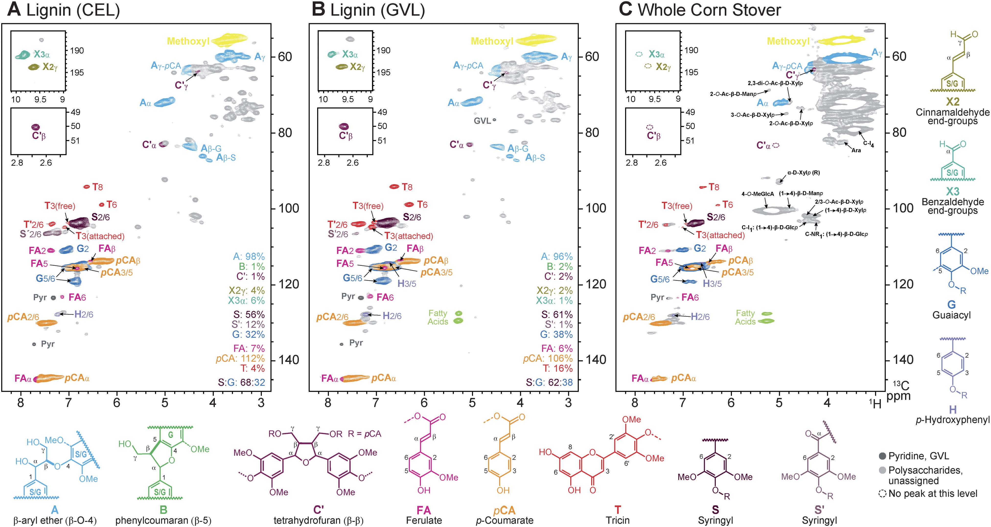
BRC Science Highlight
Lignin monomer production integrated into the γ-valerolactone (GVL) sugar platform
Objective Evaluate the integrity of GVL-derived lignin and determine the efficiency of conversion to valuable co-products such as aromatic monomers
Approach
Lignin was isolated from corn stover under mild conditions in a solvent mixture containing 80 wt% GVL and 20 wt% water
Lignin was upgraded via 2-stage hydrogenolysis over a Ru/C catalyst and efficiency of conversion to monomers was determined
Result/Impacts
Lignin retains a native-like structure as demonstrated by 2D HSQC NMR, attributable to the mild reaction conditions of the GVL process
Resulting soluble lignin-derived monomers corresponded to 48% of the carbon in the original lignin
Monomer yield and quality is on a par with that obtained from native lignin
The GVL platform could allow for easy and efficient upgrading of sugars and lignin, essential steps in the development of a successful, economically viable biorefinery.
Luterbacher, J.S. et al. 2015. Lignin monomer production integrated into the γ-valerolactone sugar platform. Energy and Environmental Science, 8:2657-2663.
GLBRC December 2015
Notes:
Notes:
text
Title again:
Text 1-2 sentence summary?

