Slide 1
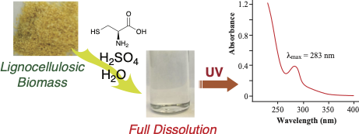
BRC Science Highlight
A safer, more efficient way to measure lignin content in biomass
Objective Develop a fast, accurate method to quantify lignin content in biomass using less energy, less starting material, and fewer toxic reagents than current processes
Approach
Completely dissolve woody biomass in 0.1 g/mL cysteine-sulfuric acid solution at 24 °C after stirring for one hour
Measure lignin content using UV spectrophotometry
Graphic of the process and chemicals used in the new CASA lignin method
Result/Impacts
The Cysteine-Assisted Sulfuric Acid (CASA) method dissolves lignin at room temperature using easily accessible and environmentally friendly reagents.
The new method yields lignin measurements comparable to the traditional Klason method in less than one-fifth of the time.
CASA requires less sample material for analysis and can be scaled up for high-throughput applications, with potential uses in the biofuels and bioproduct industries.
Lu, F., Wang, C., Chen, M., Yue, F., Ralph, J., “A facile spectroscopic method for measuring lignin content in lignocellulosic biomass.” Green Chemistry 23:5106-5012 (2021) [DOI: 10.1039/D1GC01507A]
GLBRC July 2021
Citation
Notes:
Notes:
text
Title again:
Text 1-2 sentence summary?

