Slide 1
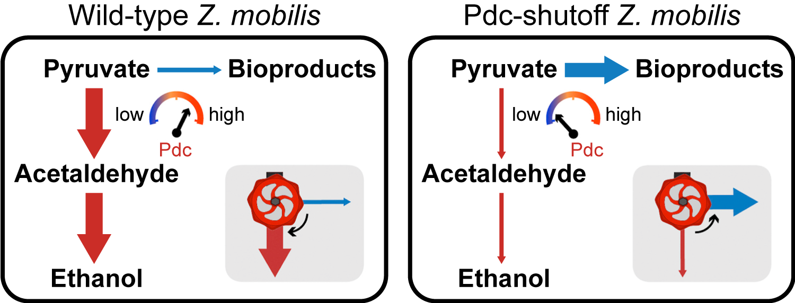
BRC Science Highlight
Controllable switch for biofuel vs. bioproducts in Zymomonas mobilis
Objective Engineer Z. mobilis to make bioproducts rather than ethanol by manipulating levels of pyruvate decarboxylase (Pdc), a key enzyme that can act as a control valve to direct carbon along different metabolic pathways.
Schematic showing modulation of metabolic control through the engineered Pdc “valve” in Z. mobilis. The weight of the arrows indicates the strength of metabolic flux through steps in the pathways.
Approach
Introduced non-native pathways for bioproduct formation; both ethanol and bioproducts are made from the same intracellular substrate, pyruvate.
Engineered pdc gene expression to respond to levels of an inducing agent so it can act as a switch.
Addition of inducing agent results in high Pdc enzyme levels and higher carbon flux toward ethanol; when inducing agent is low or absent, Pdc levels are depleted and metabolism favors bioproducts.
Result/Impacts
Pdc is essential for anaerobic growth of Z. mobilis.
An engineered Pdc “control valve” can redirect all carbon flux to 2,3-butanediol under aerobic conditions; anaerobically, flux can be redirected to redox-balanced lactate or isobutanol pathways with $≥$ 65% overall yield.
Liu, Y., Ghosh, I.N., Martien, J., Zhang, Y., Amador-Noguez, D., & Landick, R. “Regulated redirection of central carbon flux enhances anaerobic production of bioproducts in Zymomonas mobilis.” Metabolic Engineering 61, 261-274 (2020). [DOI: 10.1016/j.ymben.2020.06.005]
GLBRC September 2020
Notes:
Notes:
text
Title again:
Text 1-2 sentence summary?

