Slide 1
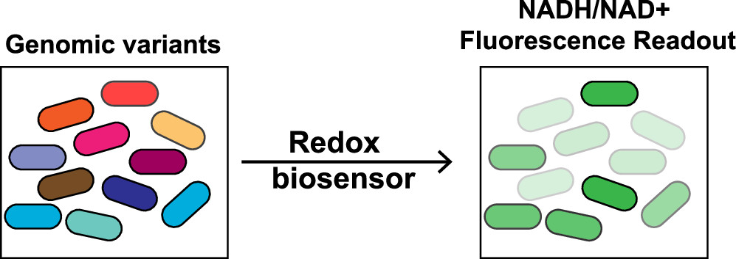
BRC Science Highlight
New biosensor highlights candidate microbes for biofuel production
Objective
Develop a genetically encoded biosensor for the NADH/NAD+ ratio in bacteria to facilitate high-throughput redox screens, enabling rapid identification of the strains best primed for biofuel production.
Approach
Designed and engineered a genetically encoded biosensor, based on a redox-responsive bacterial transcription factor, that fluoresces in response to high NADH levels.
The new genetically encoded biosensor triggers green fluorescence in cells with high NADH levels, enabling rapid identification of the strains best primed for biofuel production.
Used this biosensor to investigate the differential effects of removing various respiratory chain enzymes that normally regulate NADH and NAD+ levels in cells.
Used the biosensor to pinpoint individual cells engineered to have high NADH among a field of 10,000 wild-type cells, demonstrating its utility for high-throughput screening.
Results/Impacts
The findings suggest that the biosensor is a powerful tool for exploring and engineering redox metabolism in a variety of biological contexts.
Offers major improvements over previous methods for identifying promising microbial strains for biofuel production, making the process cheaper, faster, and more accurate.
Y. Liu, R. Landick, and S. Raman, “A Regulatory NADH/NAD+ Redox Biosensor for Bacteria.” ACS Synthetic Biology 8 (2), 264-273 (2019). 10.1021/acssynbio.8b00485
GLBRC February 2019

