Slide 1

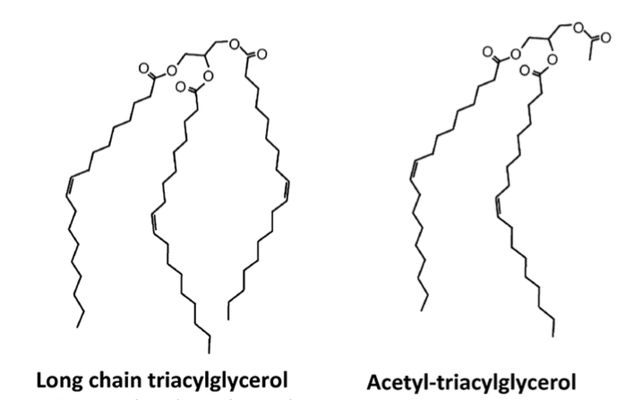
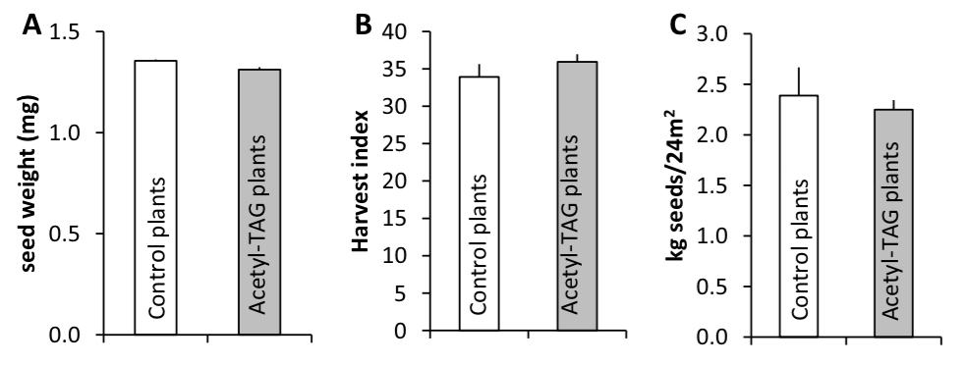
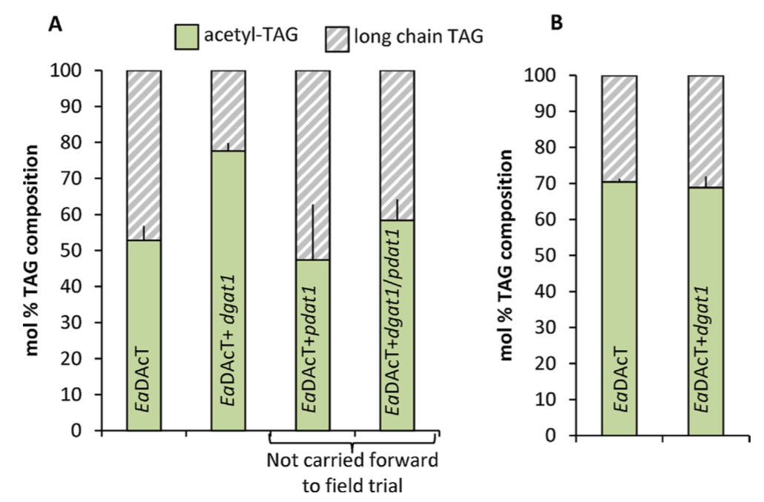
BRC Science Highlight
Field production, purification, and analysis of high-oleic acetyl-triacylglycerols (TAG) from transgenic Camelina sativa
Figure 1
Objective
To evaluate acetyl-TAG (fig 1) production and field performance of the model crop Camelina sativa genetically engineered to express Euonymous alatus diacylglycerol acetyl transferase (EaDAcT).
Approach
A high-oleic line of Camelina was engineered to produce high levels of acetyl-TAG (figure 1b) by expressing EaDAcT and down-regulating two competing metabolic pathways.
Seeds from transformed Camelina lines were bulked and used for field trials (0.7 ha total) designed to evaluate growth, yield, and acetyl-TAG production.
Assessed transgenic lines: agronomic performance versus control plants
Seed oil was extracted and analyzed for composition and physical properties
Figure 2
Figure 3
Result/Impacts
Engineering of Camelina to produce high levels of acetyl-tag had little or no impact on seed weight, harvest index, seed yield (fig 2), and oil content.
There was a significant increase in acetyl-tag oil in engineered plants (fig 3)
Achieved reductions in desirable physical properties, such as crystallization temp., viscosity, and caloric content, of oil from engineered plants.
The authors conclude that the direct production of high-oleic acetyl-TAG in crops could offer an alternative, lower-cost supply of of acetyl-TAG for food applications, biodegradable lubricants, hydraulic fluids, and drop-in diesel fuels.
Liu J, Tjellstrom H, McGlew K, Shaw V, Rice A, Simpson J, Kosma D, Wei M, Weili Y, Strawsine M, Cahoon E, Durrett T, J. Ohlrogge. Field Production, Purification, and Analysis of High-Oleic Acetyl-Triacylglyceros from Transgenic Camelina sativa. Industrial Crops and Products. 65 (2015) 259-268
GLBRC April 2015
Notes:
Notes:
text
Title again:
Text 1-2 sentence summary?

