Slide 1
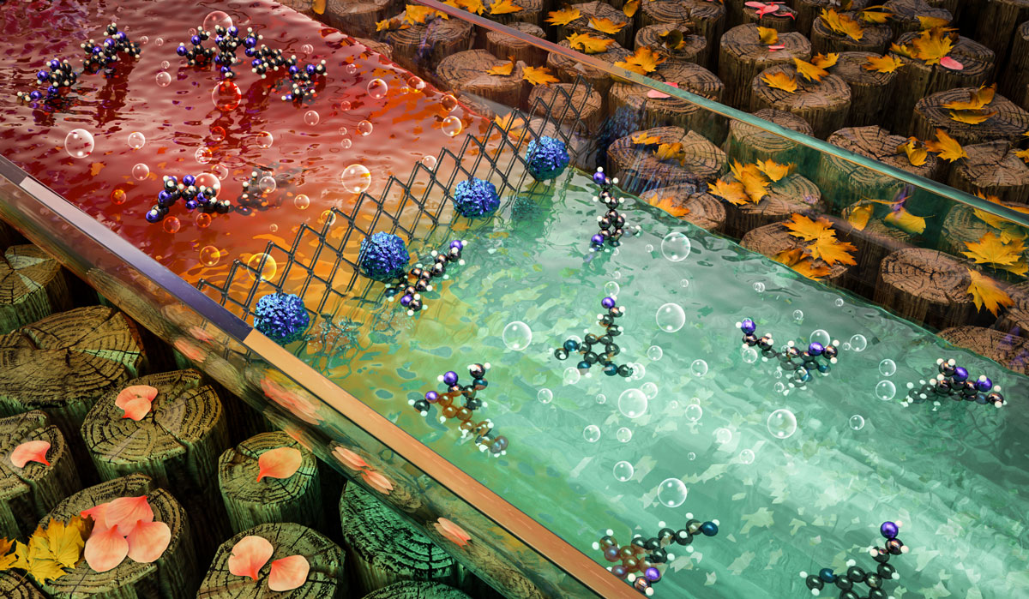
BRC Science Highlight
Hydrogenolysis offers an improved method to break down lignin
Objective
Explore lignin hydrogenolysis in a continuous-flow reactor as a method to improve depolymerization.
Approach
Evaluated the kinetics and reaction mechanisms of lignin hydrogenolysis in a continuous-flow reactor.
Optimized reaction parameters to increase monomer yield and suppress formation of unwanted byproducts.
Assessed hydrogenolysis of lignin isolated from poplar.
The article has been selected for the cover of Green Chemistry.
Results/Impacts
Lignin hydrogenolysis in the continuous-flow reactor produced lignin-derived monomer yields around 29 percent, close to the calculated theoretical maximum for lignin from pretreated biomass.
Unreacted lignin retained its native structure, allowing material to be recycled through the reactor to minimize carbon loss into unusable compounds.
Combining a continuous-flow reactor with biomass treatment processes could enhance the yield and value of product streams from a biorefinery.
Y. Li, et al. “Kinetic and mechanistic insights into hydrogenolysis of lignin to monomers in a continuous flow reactor.” Green Chemistry (2019). 10.1039/c9gc00986h
GLBRC May 2019

