Slide 1
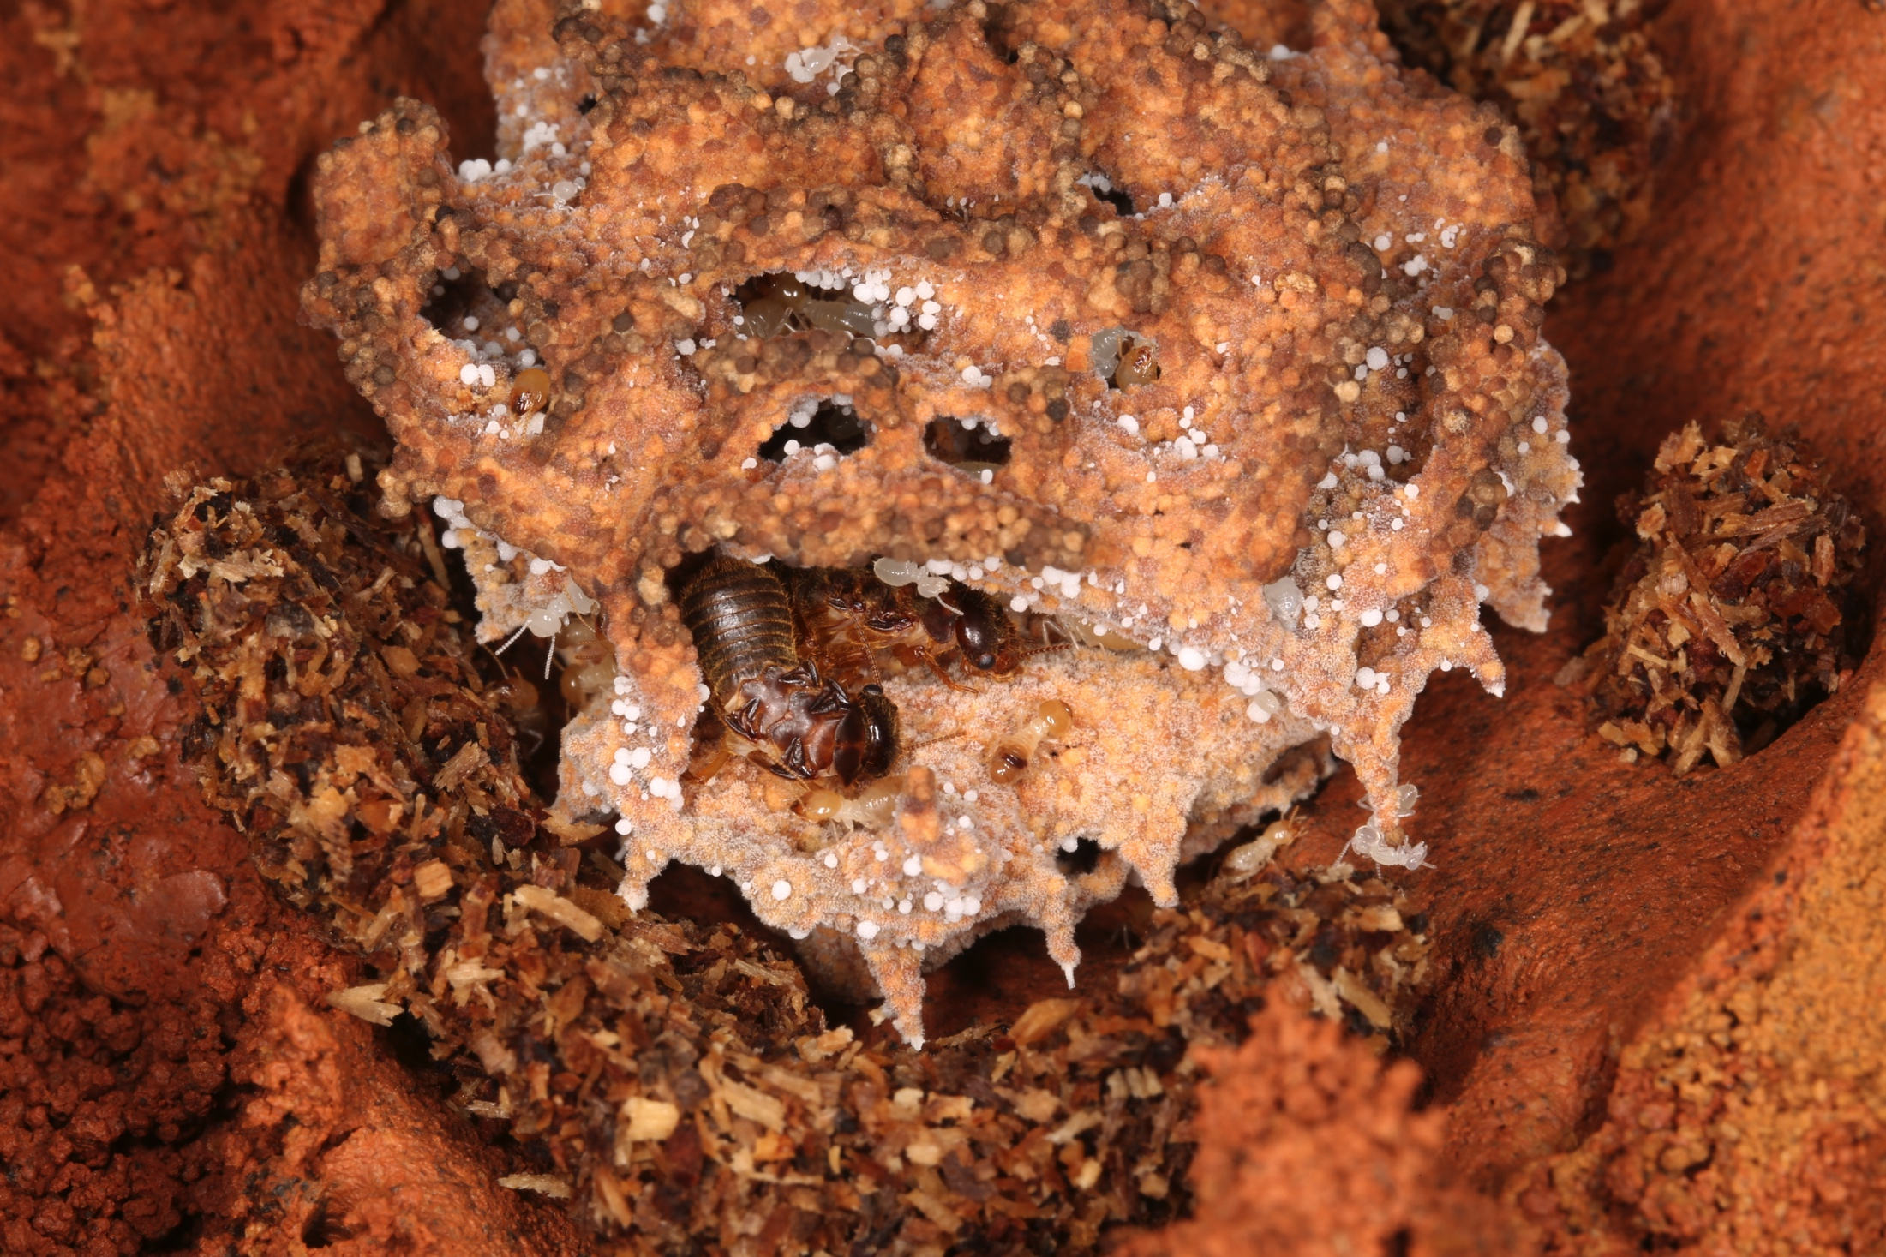
BRC Science Highlight
Fungus-cultivating termites exhibit strikingly rapid and efficient degradation of woody biomass
Objective Characterize the natural lignocellulosic degradation system in fungus-cultivating termites.
Approach
Maintain fungus-cultivating termite (Odontotermes formosanus) colonies and conduct laboratory feeding experiments using poplar wood
Analyze physical characteristics of termite colony fungus comb samples and control wood using scanning electron microscopy
Perform acid hydrolysis compositional analysis of fungus comb material and original poplar wood to determine total sugar and lignin content
Perform structural and compositional analysis of fungus comb material and original poplar wood using 2D-NMR spectroscopy, thermochemolysis, and polysaccharide analysis methods
The fungus garden of a subterranean colony of the fungus-cultivating termite Odontotermes formosanus. Worker termites ‘pre-treat’ the wood they use to grow the specialized fungus they cultivate for food. In a gut transit time of under 3.5 hours, young worker termites rapidly depolymerize and degrade even the most recalcitrant wood lignin structures.
Results/Impacts
Lignin depolymerization takes place during the rapid passage through the pH-neutral gut of young termite workers in a process that is striking in its speed and efficiency at destroying the traditionally-considered most recalcitrant C–C-bonded lignin structural units; this process releases the plant polysaccharide component, thereby facilitating efficient degradation of the substrate by processes subsequently occurring via the fungus-comb microbiome.
Thus, natural systems for lignin degradation/pretreatment are far beyond what was previously recognized and are potential sources of novel ligninolytic agents, enabling more efficient plant cell wall utilization.
Li, H. et al. “Lignocellulosic pretreatment in a fungus-cultivating termite.” Proc. Natl. Acad. Sci. USA (2017) [DOI: 10.1073/pnas.1618360114].
GLBRC April 2017
Notes:
Notes:
text
Title again:
Text 1-2 sentence summary?

