Slide 1
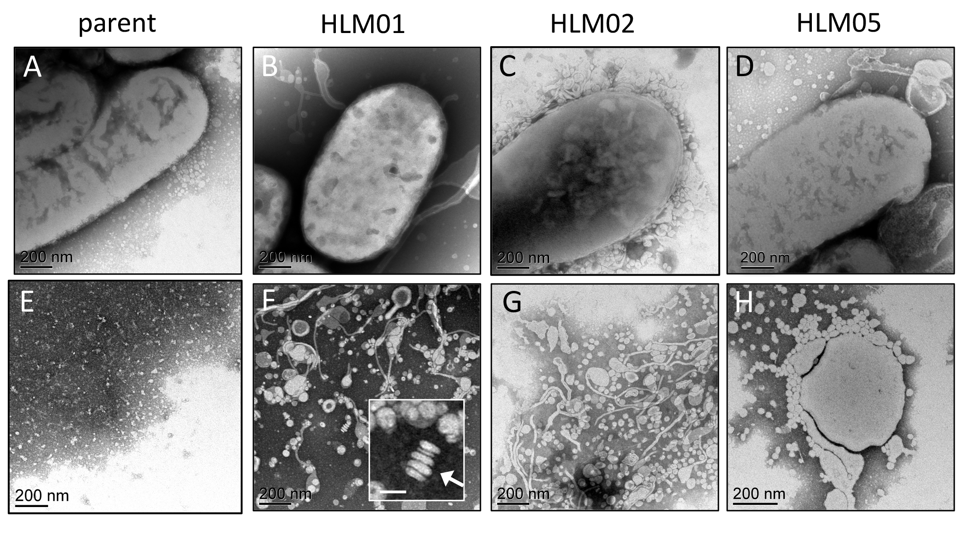
Mutations that alter the bacterial cell envelope increase lipid production
BRC Science Highlight
Objective Microbial lipids are a potential replacement for petroleum-based fuels but achieving high yields is challenging. This study sought to identify genetic factors that control microbial lipid production.
Approach
Obtained and characterized high lipid (HL)
mutants of Rhodobacter sphaeroides, a
bacterium that increases lipid membrane content under certain growth conditions.
For each of the mutant strains identified genetic alterations, used chemical sensitivity
analysis to predict cell wall changes, quantified lipid content, and examined extracellular
lipid products by transmission electron microscopy.
Transmission electron microscopy images of R. sphaeroides parental strain and high lipid mutants (HLM). Shown in panels A-D are whole mounts of cells whereas panels E-H show views of extracellular material. Arrow in inset (F) indicates a stacked structure typical of liposomes. Microscopy performed at EMSL.
Result/Impacts
HL mutants show increased lipid accumulation with alterations to the bacterial cell envelope; two HL mutants accumulated ~60% of their lipids extracellularly.
Knowledge of the mechanisms that limit microbial lipid production can inform new strategies to improve yield and enable replacement of petroleum-based fuels.
Lemmer, KC et al. Mutations that alter the bacterial cell envelope increase lipid production. mBio, DOI: 10.1128/mBio.00513-17
GLBRC May 2017
Notes:
Notes:
text
Title again:
Text 1-2 sentence summary?

