Slide 1
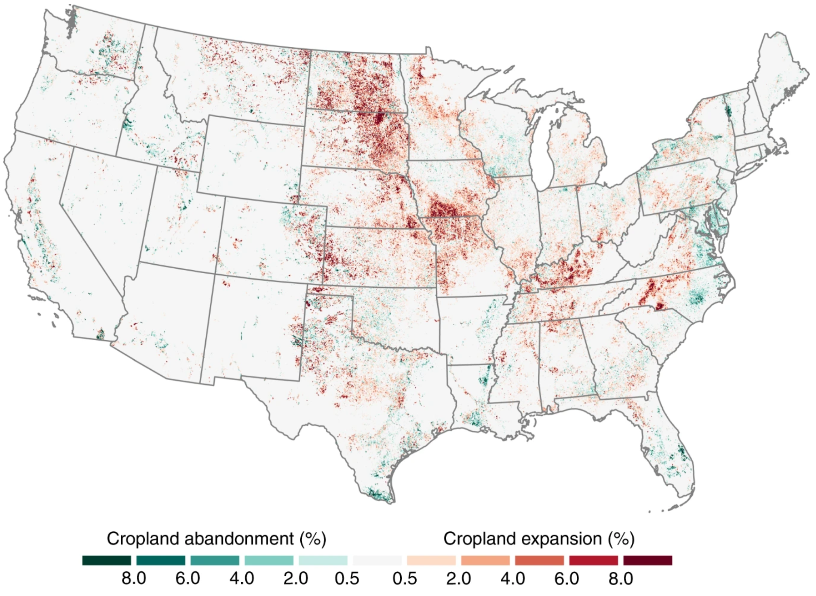
BRC Science Highlight
Consequences and tradeoffs of continued agricultural expansion in the U.S.
Objective Assess the impacts of widespread conversion of grasslands and other ecosystems into farming for corn, soybeans, and wheat from 2008 and 2016.
Approach
Identify annual differences in land use by tracking yearly field-level changes of USDA cropland maps.
Model corn, soybean, and wheat yields to simulate new cropland productivity in relation to existing fields.
Determine impacts of expansion on native plant species; evaluate effects on monarch butterflies and nesting waterfowl.
Net cropland conversion amounted to one million acres per year in the U.S. between 2008 and 2016.
Result/Impacts
Expanded croplands contained yields below the national average, representing diminished production benefits.
Land converted to crop production previously provided high quality habitat with three times more milkweeds and 37% more waterfowl nesting opportunities per acre than other natural lands.
Cultivating bioenergy crops on these lands could mitigate habitat impacts while providing revenue sources for farmers, reduced competition with food production.
Lark, T. et al., “Cropland expansion in the United States produces marginal yields at high costs to wildlife” Nature communications 11 4295 (2020). [DOI: 10.1038/s41467-020-18045-z]
GLBRC October 2020
Notes:
Notes:
text
Title again:
Text 1-2 sentence summary?

