Slide 1
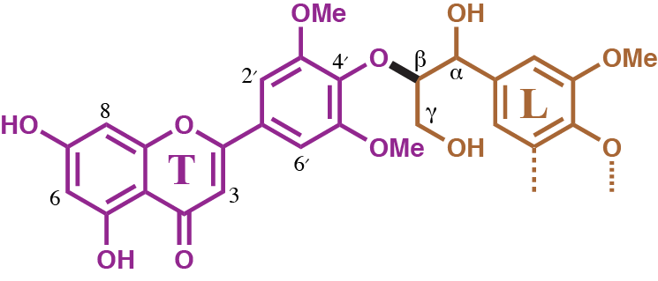
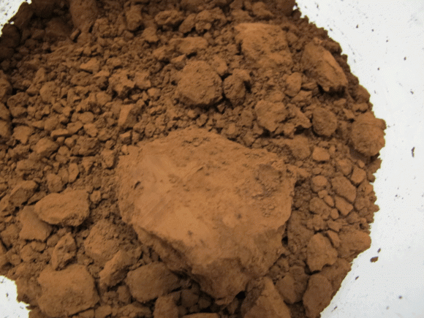
BRC Science Highlight
Tricin, a flavonoid monomer in monocot lignification
Objective To provide proof that tricin is involved in lignification and establish the mechanism by which it incorporates into the lignin polymer
Approach
Synthesize the 4'-O-β-coupling products of tricin with the monolignols (p-coumaryl, coniferyl, and sinapyl alcohols), along with the trimer that would result from tricin’s 4'-O-β-coupling with sinapyl alcohol and then coniferyl alcohol
Apply two standard methods to determine whether tricin is capable of reacting with monolignols under radical coupling conditions; elucidate the nature of the resulting products by NMR
Characterize fractionated maize lignin using NMR
Result/Impacts
Tricin is able to couple with monolignols and participate in lignification, and regularly does so in monocots where tricin is found covalently bound within the lignin polymer itself
Tricin acts as an initiator, as it is only found at the beginning of the polymer chain
Incorporation of tricin into monocot lignins provides a new, extractable source of this valuable flavonoid, recognized for its antioxidant, anti-aging, anticancer, and cardioprotective properties
Lan W, Lu F, Regner M, Zhu Y, Rencoret J, Ralph SA, Zakai UI, Morreel K, Boerjan W, Ralph J (2015) Tricin, a flavonoid monomer in monocot lignification. Plant Physiology 167, 1284-1295.
GLBRC October 2015
Notes:
Notes:
text
Title again:
Text 1-2 sentence summary?

