Slide 1
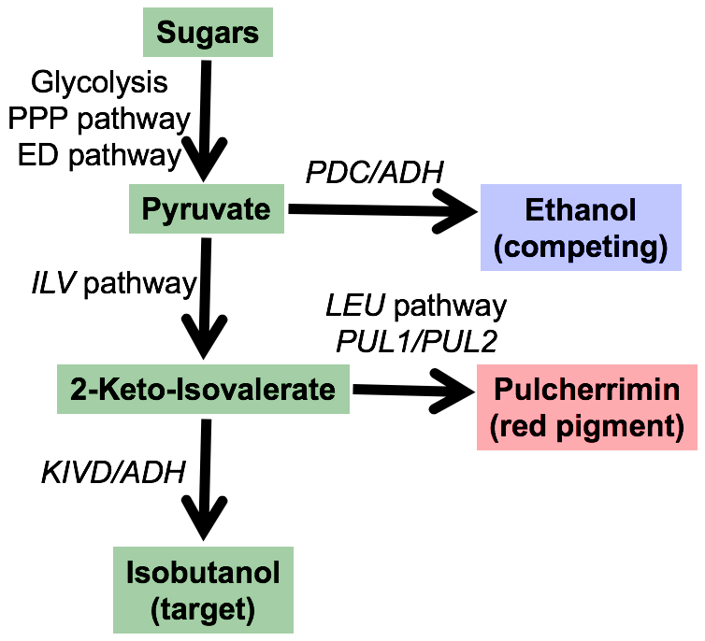
BRC Science Highlight
Identification of a secondary metabolite gene cluster in budding yeasts with important implications for biofuel production
Objective
Identify the genes responsible for production of the secondary metabolite pulcherrimin within the yeast subphylum Saccharomycotina; characterize and assign putative functions for each of the genes.
Approach
The genomes of 90 species of budding yeast were compared and a four-gene cluster associated with pulcherrimin was identified.
Targeted gene knockouts in Kluyveromyces lactis suggested that the gene cluster consists of two pulcherriminic acid biosynthesis genes, a pulcherrimin transporter, and a putative transcription factor.
Result/Impacts
This secondary metabolite gene cluster is the first identified in budding yeasts. Pulcherrimin appears to act as a siderophore (chelator of environmental iron) that may provide an advantage to ”cheaters”: species that lack the ability to produce pulcherrimin but can transport and utilize pulcherrimin-complexed iron.
Both pulcherrimin and isobutanol are derived from a common pathway and some yeasts are particularly adept at making pulcherrimin; the metabolic control of pulcherrimin biosynthesis may lend insight to boost isobutanol production in non-producing model strains such as S. cerevisiae.
Krause, D. et al. 2018. Functional and evolutionary characterization of a secondary metabolite gene cluster in budding yeasts. PNAS, DOI: 10.1073/pnas.1806268115.
GLBRC October 2018
Notes:
Notes:
text
Title again:
Text 1-2 sentence summary?

