Slide 1
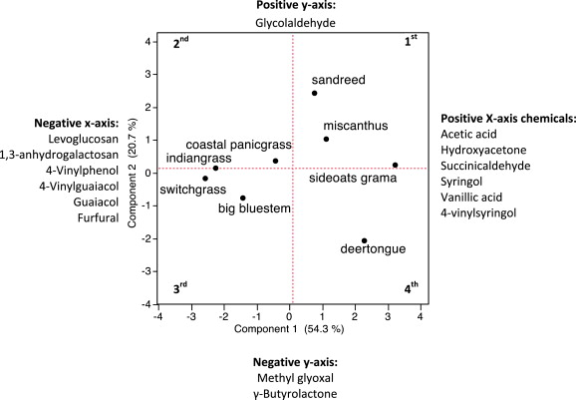
BRC Science Highlight
Pyrolysis of Grass Species in North-America
Objective To understand the effects of feedstock compositional variability on fast pyrolysis.
Approach
Composition and pretreatment data of eight North-American native grass species were examined and related to the most typical chemical products resulting from plant tissue pyrolysis.
Grasses used were: big bluestem, coastal panicgrass, deertongue, indiangrass, Miscanthus, prairie sandreed, sideoats grama, and switchgrass.
Result/Impacts
Principal Component Analysis (PCA) identified significant variability in the pyrolysis products, however, no connection to the the taxonomic tribe (Andropogoneae or Paniceae tribes, to which all grasses in this study belong) could be made in this study.
When considering bioenergy production via pyrolysis, composition analysis done in this study suggests that coastal panicgrass may be more suitable, whereas sideoats grama and deertongue may be better suited for fermentation-based processes.
Kelkar, S., Li, Z., Bovee, J., Thelen, K.D., Kriegel, R.M., Saffron, C.M. “Pyrolysis of North-American grass species: Effect of feedstock composition and taxonomy on pyrolysis products”. Biomass and Bionenergy(2015). Doi: 0.1016/j.biombioe.2014.03.032
GLBRC April 2015
Notes:
Notes:
text
Title again:
Text 1-2 sentence summary?

