Slide 1
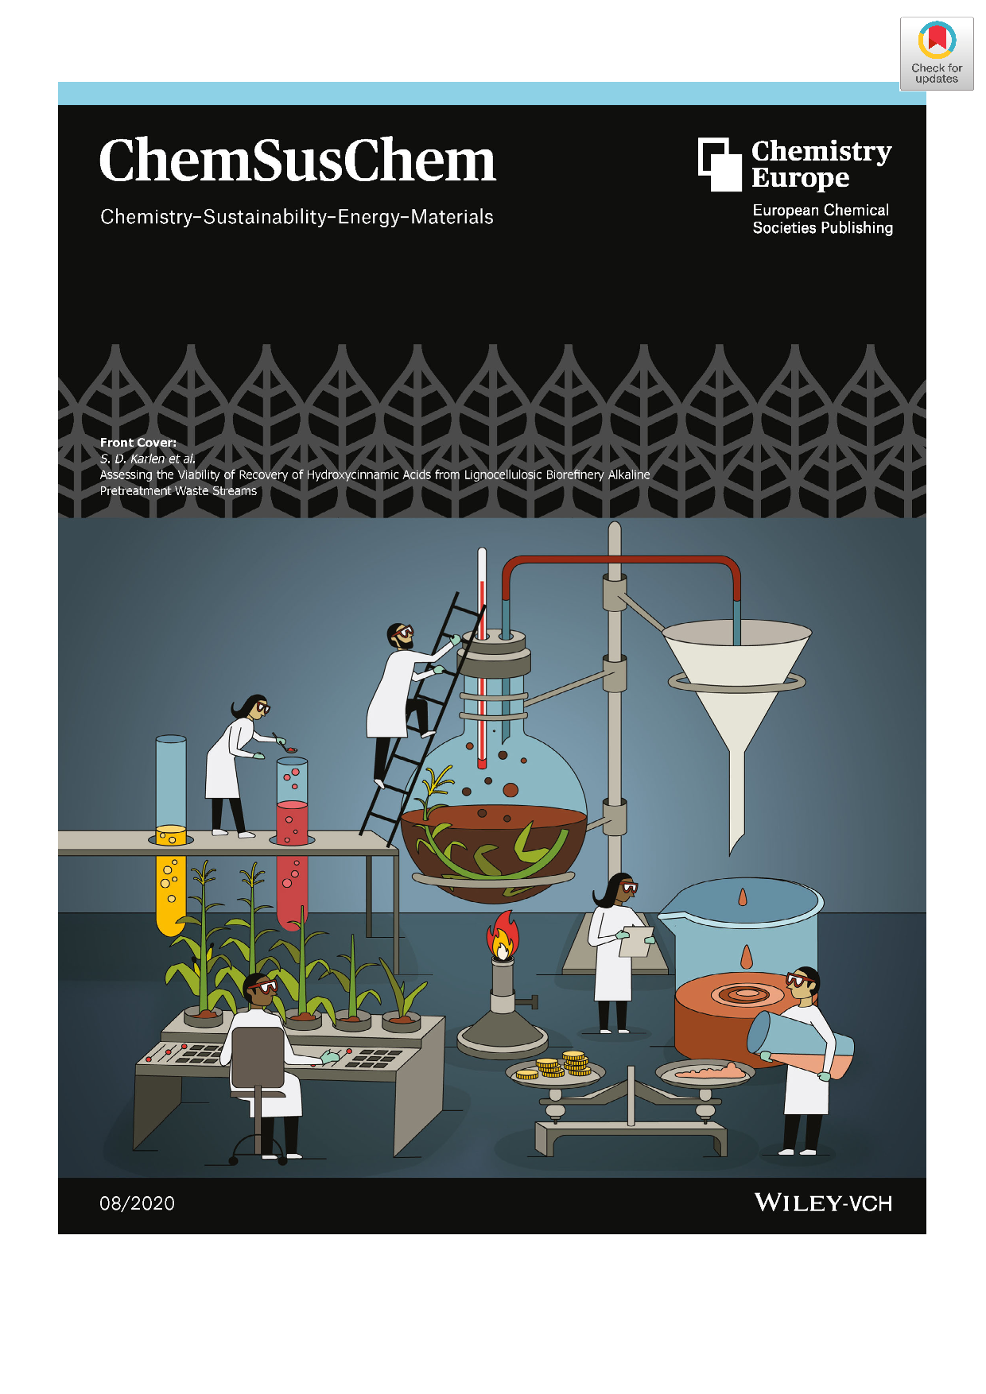
BRC Science Highlight
Using coproducts from lignin to increase value from biorefineries
Objective
Combine laboratory research and modeling simulations to determine the viability of producing coproducts from lignin to improve the economics of lignocellulosic biorefineries.
Approach
Integrate field-to-refinery research: crop engineering to enhance production of lignin-bound, high-value chemicals; field trials to assess plant viability; lab-scale biomass pretreatment to release the high-value chemicals; yield quantification.
Establish a baseline technoeconomic analysis of this ‘lignin-first’ strategy to determine where to focus future research efforts.
Results/Impacts
Assessment of the full biorefinery system, from field to the liquid fuels and coproducts, identified key parameters needed to design an economically viable biorefinery-based model.
Technoeconomic analysis indicates that cost effective coproduct recovery will require channeling coproducts to a single useful product at high titers — at least five times higher than observed for the hydroxycinnamic acids studied in this work.
Process engineers should develop a viable coproduct isolation process that reduces costs by more than 80%.
S. D. Karlen et al. “Assessing the viability of recovery hydroxycinnamic acids from lignocellulosic biorefinery alkaline pretreatment waste streams.” ChemSusChem (2020) [DOI: 10.1002/cssc.201903345]
GLBRC April 2020

