Slide 1
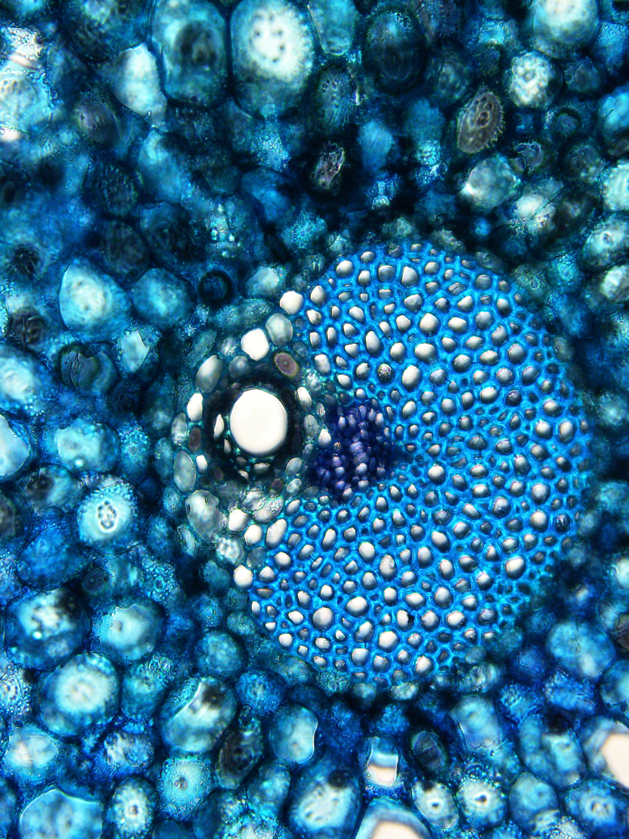
BRC Science Highlight
Complex lignin composition identified in leaf tissues of the Canary Island date palm
Objective Examine the lignin of cell walls from different regions of the leaves of the palm Phoenix canariensis to investigate whether differences in tissue region coincide with differences in lignin composition.
Approach
Dissect date palm leaf-base tissue into inner and outer tissue regions; use bright-field microscopy to examine the anatomies of these regions.
Use mild alkaline hydrolysis to release and quantify lignin components; use 2D heteronuclear single-quantum coherence (HSQC) NMR spectroscopy to reveal lignin decoration present in the different tissues.
Determine lignin composition using derivatization followed by reductive cleavage (DFRC) and the modified DFRC-Pr method.
Results/Impacts
Leaf-base tissues of Phoenix canariensis contain complex lignins comprised of an unprecedented range of monolignol (ML) conjugates, including ML-benzoate and ML-vanillate, not previously known to be involved in lignification.
Understanding the plasticity of lignin biosynthesis, including identifying which monolignol conjugates are used in lignification in the wide variety of plant species available in nature, enables lignin valorization, both through extraction of naturally-occurring components and of compounds that have been engineered into bioenergy crops.
A cross-section cut from the leaf base of the palm Phoenix canariensis showing a vascular bundle with lignified cell walls stained light blue and primary cell walls stained purple. The lignified cell walls have higher levels of benzoate esters than other parts of the leaf base.
Karlen, S. D. et al. “Highly decorated lignins in leaf tissues of the Canary Island date palm Phoenix canariensis.” Plant Physiology 175, 1058-1067 (2017) [DOI: 10.1104/pp.17.01172].
GLBRC November 2017
Notes:
Notes:
text
Title again:
Text 1-2 sentence summary?

