Slide 1
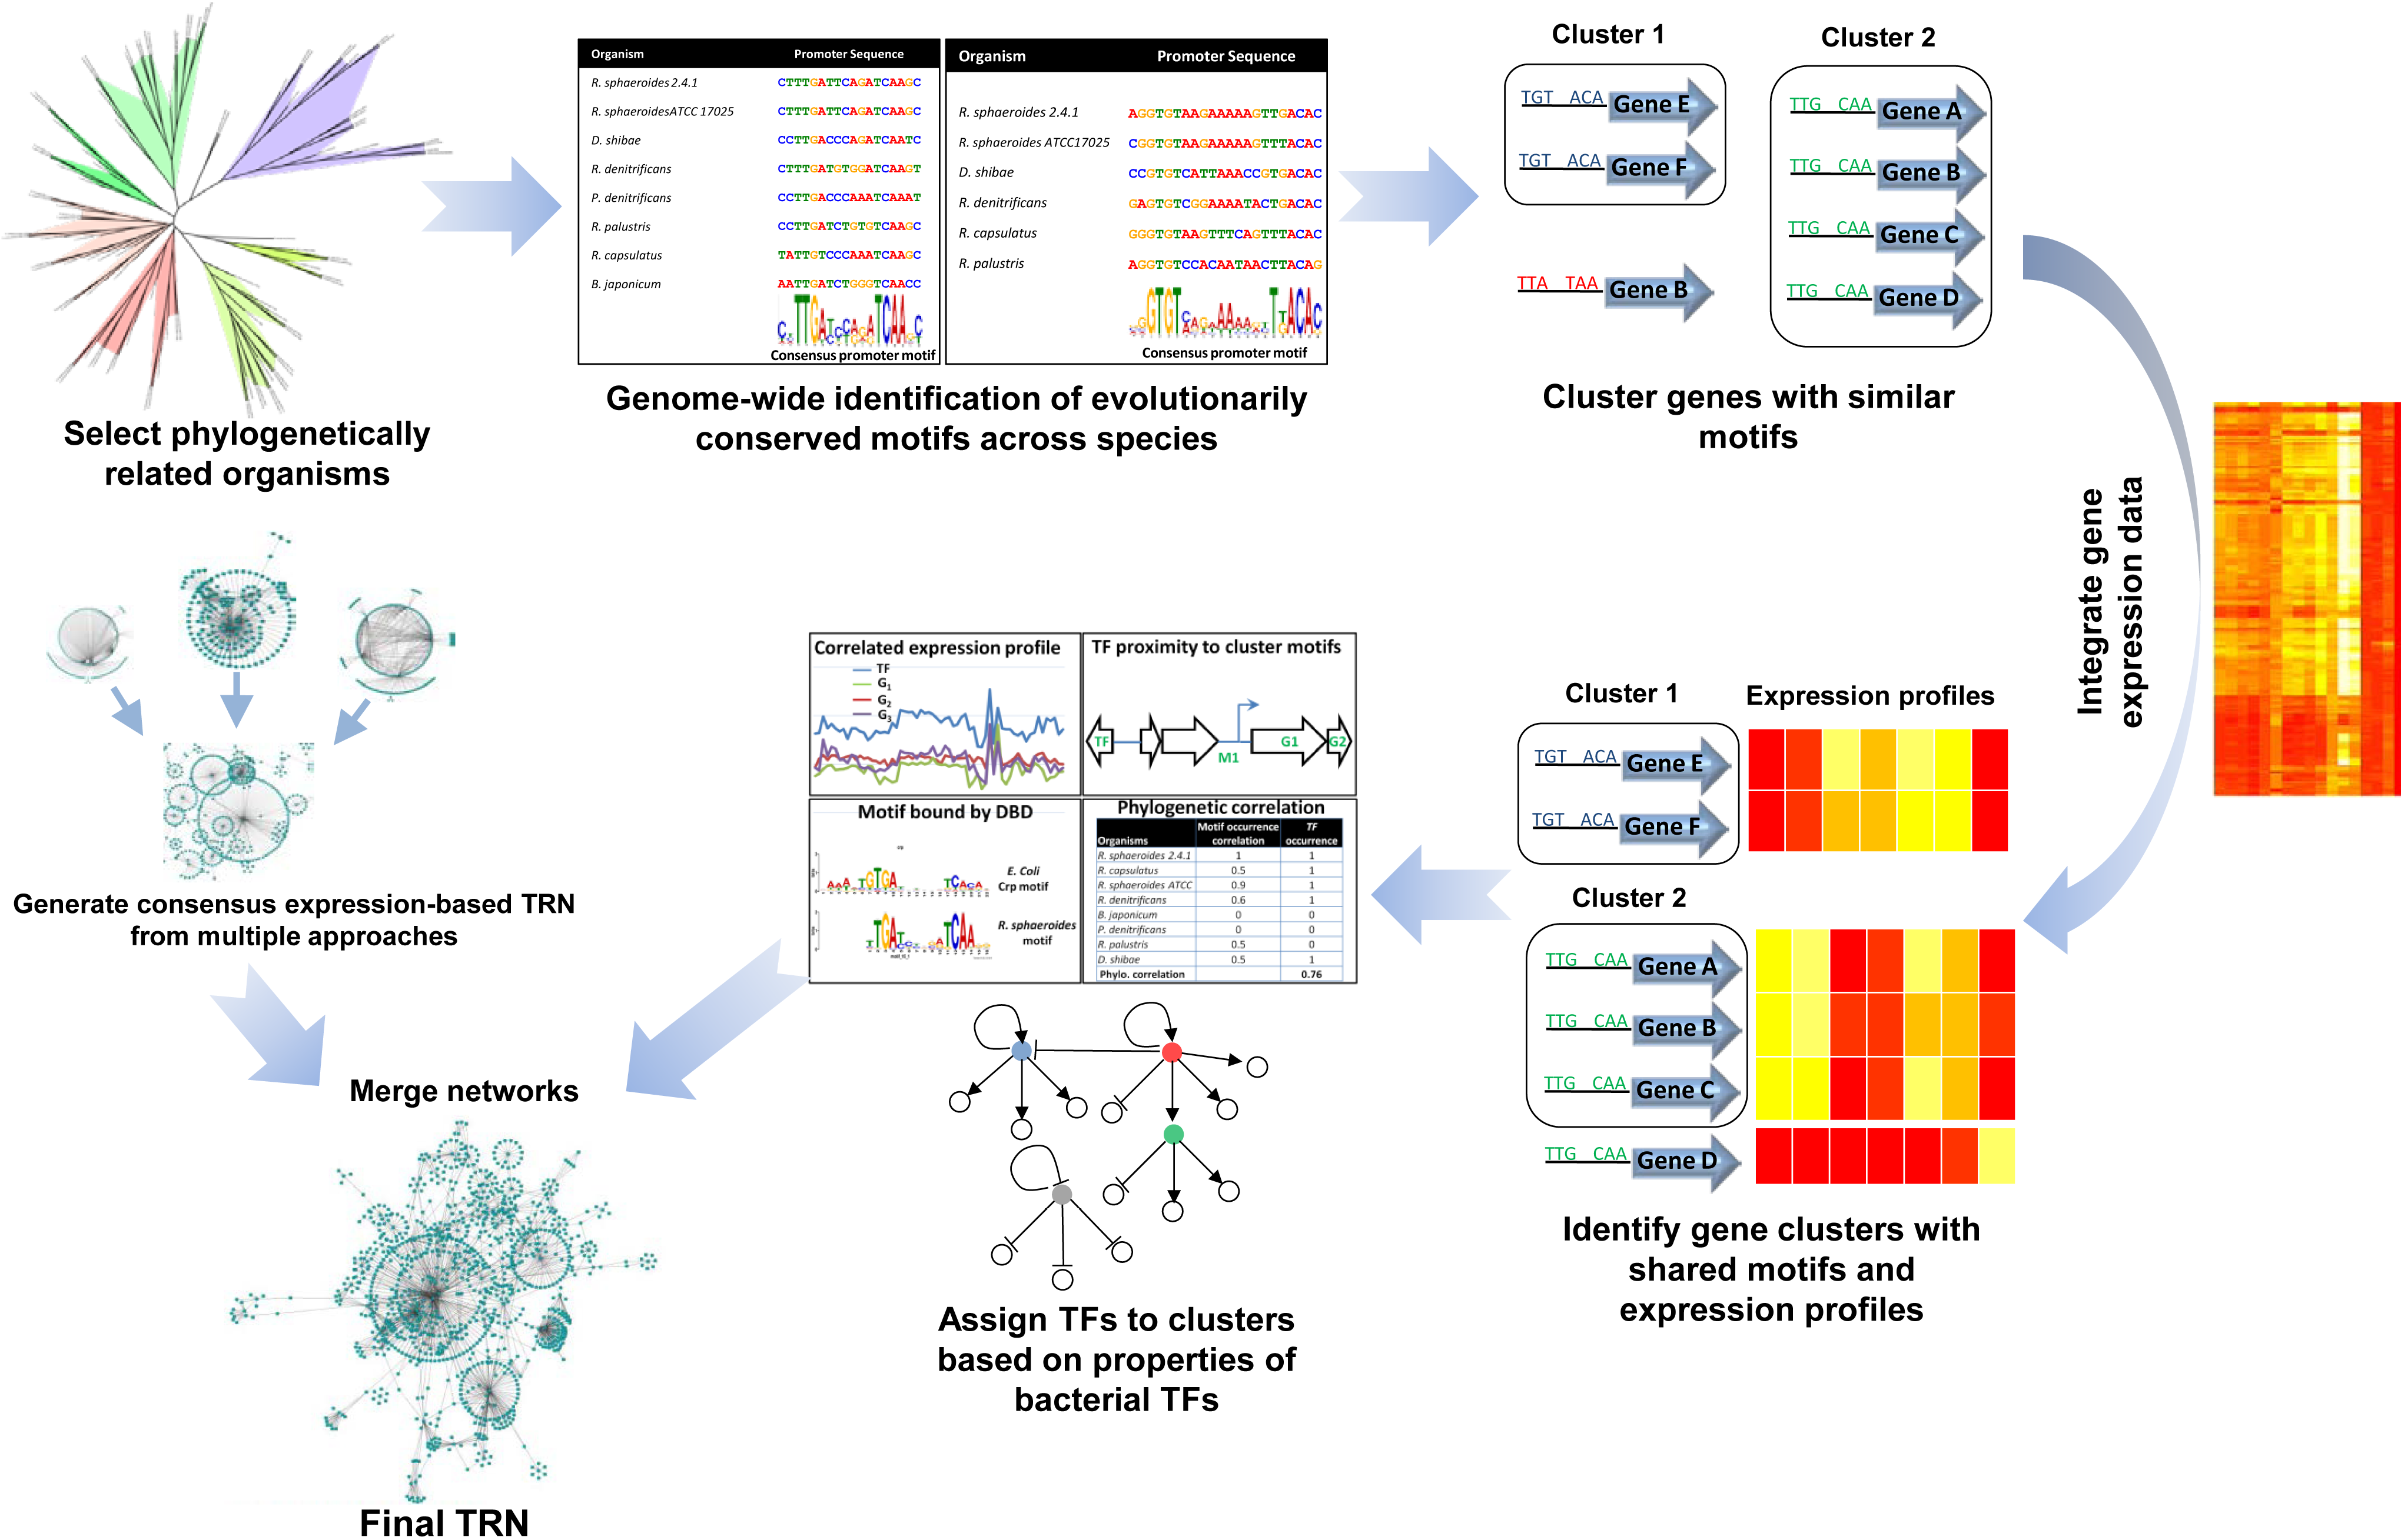
BRC Science Highlight
An integrated approach to reconstructing genome-scale transcriptional regulatory networks (TRNs)
Objective To expand the predictive power and information content of transcriptional regulatory networks (TRNs) in biological systems beyond current capabilities
Approach
Integrate comparative genomics and motif analysis with traditional gene expression-based methods
Validate work flow for TRN development in well-studied microbes; uncover new regulatory modules or circuitry
Result/Impacts
The integrated approach is more accurate and captures a larger fraction of known regulatory interactions
Translational tool that can readily reconstruct TRNs from related organisms
The integrative method for TRN reconstruction will soon be available through Kbase
Imam S, Nogeura DR, Donohue TJ (2015) An integrated approach to reconstructing genome-scale transcriptional regulatory networks. PLoS Computational Biology 11: e1004103.
GLBRC March 2015
Notes:
Notes:
text
Title again:
Text 1-2 sentence summary?

